Slide 1
Module - 2
Demographic Data Entry

Slide 2
Objectives
In this module you will learn about:
The hierarchy of organizations in the enrolment process
The enrolment process flow
The First Mile Logistics and Document handling
The process of data de-duplication and Aadhaar generation
The roles and responsibilities of agencies and people involved in enrolment
The standards and guidelines, as suggested by Unique Identification Authority of India (UIDAI)
Notes:
Trainer to say:
The objectives of this module are <read form the slide>

Slide 3
Recap of UIDAI & Aadhaar
Quick Recap
Aadhaar is a ________ number that _________will provide to the ________ of India after collecting and verifying their _________and __________ data.
Notes:
Trainer to say:
Before we proceed, let us quickly recap some important points from the first session.
<After giving about 2 minutes to the participants, share the correct answers (below):>
Aadhaar is a 12-digit number that the Unique Identification Authority of India (UIDAI) will provide to the residents of India after collecting and verifying their demographic (e.g., location) and biometric (e.g., thumbprint) data.

Slide 4
What is Enrolment?
Recap of UIDAI & Aadhaar
The process of collecting demographic and biometric data from residents is known as enrolment.
Notes:
Trainer to ask:
What do you think the term “enrolment” means in the context of UIDAI?

Slide 5
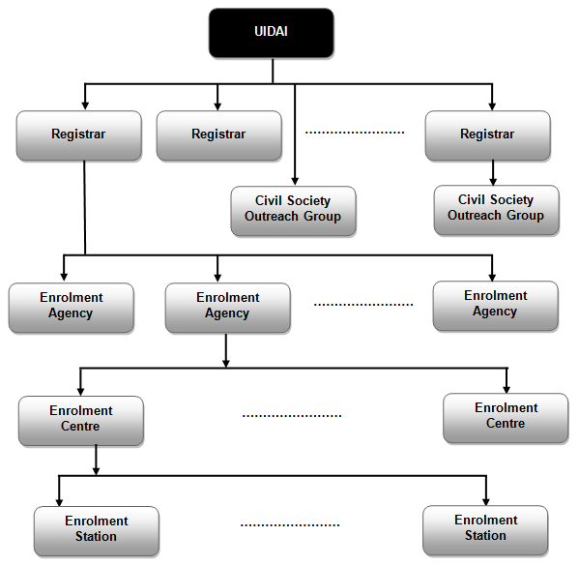
Aadhaar Enrolment Process - Entities
Outline of Enrolment Hierarchy
Notes:
Trainer to say:
The UIDAI will partner with a variety of organizations to enroll residents for Aadhaar and verify their identity.
Who are these entities? Let us see
Registrar.
Under the Registrar you have the Enrolment Agency.
Under the Enrolment Agency, you have the Enrolment Centres.
Finally, there are the Enrolment stations.

Slide 6
Aadhaar Enrolment Process – Entities: Registrar
Who Qualifies to be a Registrar?
Departments of the Central or State Government.
AND
Large public and private sector organizations with whom the UIDAI has entered into a memorandum of understanding (MoU) for on-field implementation of the UID project.
Notes:
Trainer to say:
Let us look at the first entity involved in the enrolment process – the Registrar.
<Click on any key……..>
Trainer to read: Who qualifies to be a registrar?
<Click on any key……..>
Trainer to read from the slide.
Trainer to elaborate on this slide by sharing the following points:
State governments & their departments
Central Government Ministries & their undertakings/committees such as (but not limited to):
Registrar General of India (RGI) under Ministry of Home Affairs
Oil PSUs under Ministry of Petroleum
Large Public & Private sector organizations such as (but not limited to):
Public sector banks
Public sector insurance organizations
Public sector telecom organizations
Private sector banks
Private sector insurance organizations
Private sector telecom organizations

Slide 7
Aadhaar Enrolment Process – Entities: Enrolment Agency
Enrolment Agencies
These are agencies appointed by the Registrar for the collection of demographic and biometric data in areas assigned by the Registrar.
They may be third party agencies empanelled by UIDAI.
Notes:
Trainer to say:
Let us look at the third entity involved in the enrolment process – the Enrolment agencies.
<Click any key…….>
Trainer to say:
We will now see how Enrolment agencies are set up
Enrolment Agencies are hired by Registrars
They could be third party agencies that are empanelled by the UIDAI
They could also be existing offices of the Registrar like the LIC using its own offices and staff etc.

Slide 8
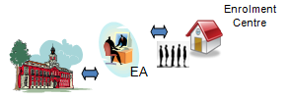
Aadhaar Enrolment Process – Entities: Enrolment Agency -> Enrolment Centre
UIDAI
Registrar
Enrolment Agency
Mobile, Temporary, or Permanent
Enrolment Centre
Enrolment Station
Notes:
Trainer to say:
Next we look at the fourth entity involved in the enrolment process – the Enrolment Centre .
<Click on any key…….>
As we just saw, the enrolment Centre is set up by the enrolment agencies.
<Click on any key…….>
Enrolment Centres may be mobile, temporary or permanent
For hard-to-reach areas, Enrolment Centres may be mobile
It may also be temporarily set up for the initial completion of enrolment of residents of that region
OR it may be Permanent to ensure ongoing enrolments and updates

Slide 9
Aadhaar Enrolment Process – Entities: Enrolment Agency -> Enrolment Centre -> Enrolment station
UIDAI
Registrar
Enrolment Agency
Enrolment Centre
Computer with Enrolment Client Software & other Devices
Enrolment Station
Notes:
Trainer to say:
The last and final entity is the Enrolment Station. An Enrolment Centre can have one or more Enrolment Stations.
<Click an key……>
An Enrolment Centre is where residents would get themselves enrolled. The actual enrolment is performed using an Enrolment station, which consists of
<Click an key……>
A computer (laptop/desktop) with the enrolment client software installed
Biometric data capture devices
Printers
Photocopiers
Other devices as prescribed by UIDAI

Slide 10
Toll-free Number to Address Grievances
Aadhaar Enrolment Process – Entities: Contact Centre
1800-300-1947
Notes:
Trainer to say (dramatically):
That seems like a phone number! Whose number is this?
UIDAI has set up a grievance handling contact Centre where residents can call and get their queries resolved.
This is an all India toll-free number.
This is an important piece of information which we should always remember!

Slide 11
Aadhaar Enrolment Process – Stages
Step 1 Setting up an Enrolment Centre
Step 2 Capturing residents’ demographic and biometric data
Step 3 Backup of data and Sync
Step 4 Transfer the demographic and biometric data to the CIDR
Step 5 Data de-duplication and Aadhaar generation at CIDR
Step 6 Mailing the Aadhaar in a letter to the resident
Notes:
Trainer to ask:
Let us now look at the overall process for enrolling residents. Do you think there is planning, executing, checking and implementing?
ETH: Yes
Trainer to ask:
Can we try to map the steps here with Planning, Executing, Checking and Implementing?
<Read each step from the slide and ask participants to say whether it is planning, executing, checking and implementing>
The last step in this process may be termed as “Close”
Trainer to say:
We will now take up each step and learn about the tasks involved in detail. Let’s start with Step 1.

Slide 12
Setting up an Enrolment Centre
The Enrolment Agency helps the Registrar to identify suitable locations where Enrolment Centres can be set up.
The Enrolment Agency helps the Registrar in deciding the number of Enrolment Stations for each Enrolment Centre.
The Enrolment Agency deploys required hardware devices and software.
The Registrar loads the KYR+ application and provides residents’ pre-enrolment data, if available.
The Enrolment Agency loads residents’ pre-enrolment data onto the Enrolment Station’s computers.
UIDAI provides content to the Registrar for awareness and publicity.
The Enrolment Agency helps the Registrar in creating awareness among residents.
The Enrolment Agency ensures the availability of certified Operators and Supervisors.
Enrolment Agency completes on-boarding of Operators, Supervisors and Introducers (OSI)
The Enrolment Agency ensures site readiness and fills out relevant checklists.
The Registrar audits site readiness.
Notes:
Trainer to say:
The first step as we saw is to set up the enrolment Centre.
This step involves the following tasks.
<Read from the slide>
<Tell the participants that O stands for Operator, S stands for Supervisor, I stands for Introducer and EA stands for Enrolment Agency.>
Trainer to say:
There are some guidelines and sub-tasks involved for performing each of these tasks. THIS ENTIRE PROCESS WILL BE COVERED IN MODULE 3A – “Setting up of an Enrolment Centre”.

Slide 13
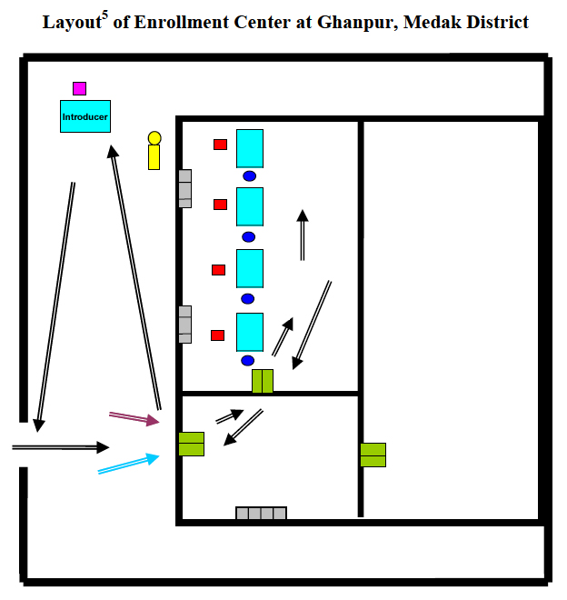
Typical Layout of an Enrolment Centre
Notes:
Trainer to say:
The RED squares indicate position of the Enrolment Operator.
The BLUE circles indicate position of the resident being enrolled.

Slide 14
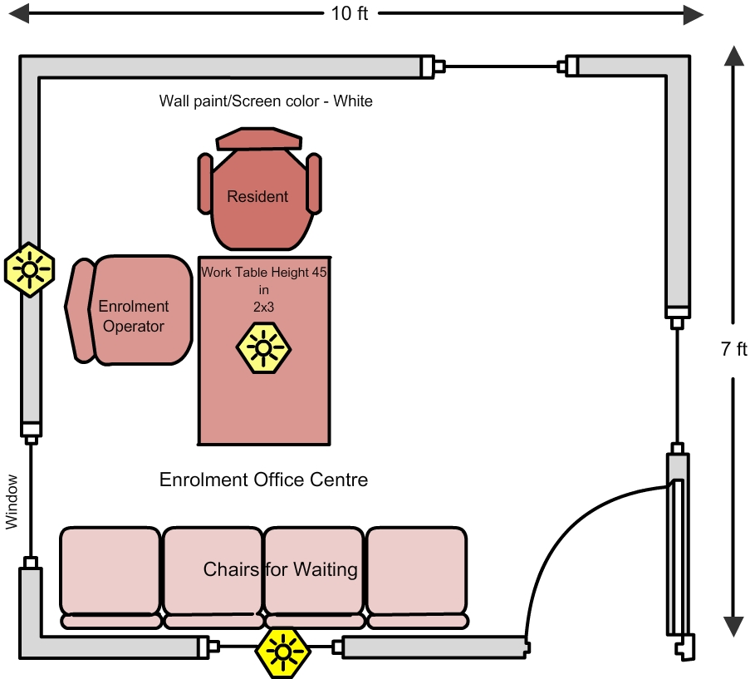
Guidelines for Setting up the Enrolment Centre
Enrolment Centre Layout
Notes:
Trainer to say:
Explain the position of Enrolment Operator, Resident and other components of the Enrolment Centre.

Slide 15
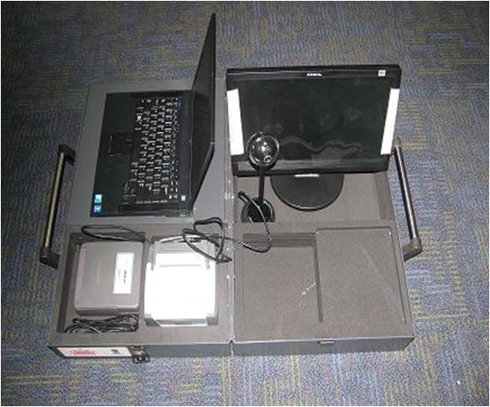
An Enrolment Station
While setting up an Enrolment Centre, the Enrolment Agency has to procure the necessary hardware, software and other infrastructure.
Notes:
Trainer can say:
This is a carry case which can hold an entire Enrolment Station.
Trainer can point to a device and ask the audience to identify it.

Slide 16
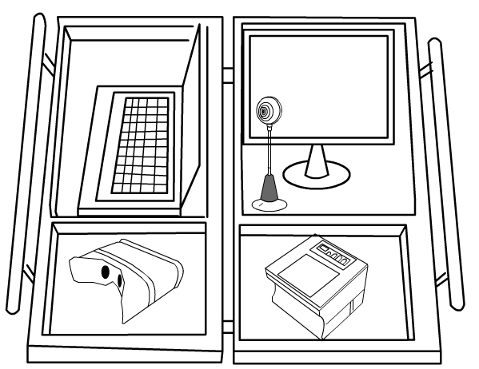
An Enrolment Station
Notes:
Trainer to say:
Explain the position of different components of Enrolment Station.

Slide 17
Setting up an enrolment station
Every Enrolment Station should have the items as shown in the following table.
Sl. No. | Item | Comment
1 | Laptop | Should be installed, tested, configured, and registered with CIDR as per installation and configuration manual.
2 | UIDAI enrolment software loaded on the laptops | The detailed process of loading Introducers data into Aadhaar Enrolment Client is covered in the "Module 3B – Aadhaar Enrolment Client Installation and Configuration"
3 | List of Introducers loaded on laptop | Record Make & Model
4 | Iris capturing device | Record Make & Model
5 | Fingerprint capturing device | Record Make & Model
6 | Digital Camera | For taking facial photographs backdrop
7 | White back ground screen | For residents to verify their data
Notes:
Trainer to say:
Explain the items required for setting up Enrolment Station.

Slide 18
Setting up an enrolment station (contd.)
Sl. No. | Item | Comment
8 | Extra monitor (15-16" with a resolution above 1024x768) | For residents to verify their data
9 | Portable External Hard Disk Drive | For exporting of captured data and also for daily backup. Enrolment Centre should maintain a stock of 20 days.
10 | GPS Dongle | To identify the physical location of the enrolment station
11 | Printer – Ink Jet or Laser | A4 or bigger printer; printer should be able to print facial image.
12 | Printer Paper | Should maintain inventory for 5 Enrolment Stations for 10 days i.e. approximately 20 rims.
13 | Antivirus / Anti Spyware software loaded on the laptops
Notes:
Trainer to say:
Explain the items required for setting up Enrolment Station.

Slide 19
Setting up an enrolment station (contd.)
Sl. No. | Item | Comment
14 | Data Card /Internet connectivity | For onboarding of the users and online syncing of Enrolment Client with CIDR in every 24-48 hrs. The Client will stop enrolments if the client is not synched at least once in 10 days.
15 | Download and install latest version of Aadhaar SFTP client from http://upload.uidai.gov.in/ | For packet upload to CIDR. SFTP Client may be installed only on those stations which will be used for data packets upload.
16 | All Operators and Supervisors of an Enrolment Station should be enrolled into Aadhaar, certified, activated in tech portal and onboarded
17 | The pre-enrolment data from the Registrars, if used, should be available for import on laptops
Notes:
Trainer to say:
Explain the items required for setting up Enrolment Station.

Slide 20
Setting up an enrolment station (contd.)
Sl. No. | Item | Comment
18 | If Registrar has additional fields to be captured, then the KYR+ software for capturing the KYR+ fields is configured and tested
19 | Make sure all deployed machines are active at technology portal and machines no longer used in enrolment are decommissioned as per policy
Notes:
Trainer to say:
Explain the items required for setting up Enrolment Station.

Slide 21
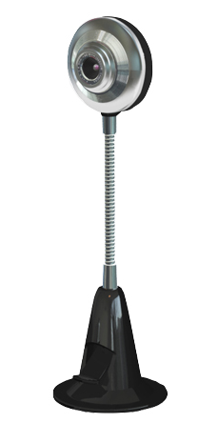
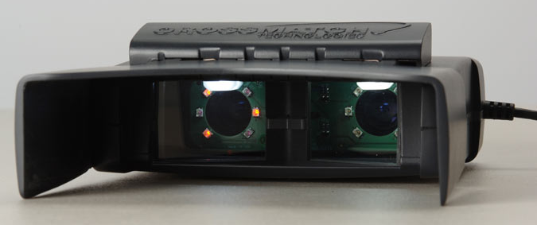
Setting up biometric devices
Steps for connecting the biometric devices
  Place the digital camera in proper position such that the facial image of the enrollee can be captured easily and correctly. Connect the camera to the USB port of the computer.
  Connect the Iris Scanner to the USB port of the computer.
Notes:
21
Trainer to say:
Following are the steps to connect the Biometric Devices:
Place the digital camera in proper position so that the facial image of the enrollee can be captured. Connect the camera to the USB port.
Connect the Iris Scanner to the USB port.

Slide 22
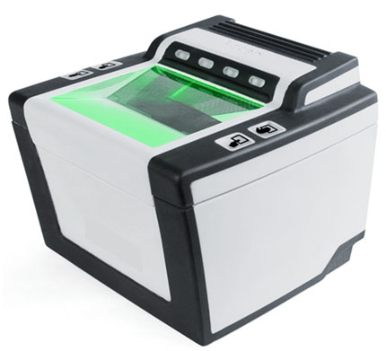
Setting up biometric devices
Steps for connecting the biometric devices
  Connect the fingerprint scanner to the USB port of the computer.
Notes:
22
Trainer to say:
Following are the steps to connect the Biometric Devices:
Connect the Fingerprint Scanner to the USB port of the computer.

Slide 23
Aadhaar Enrolment Process – Stages
Step 1 Setting up an Enrolment Centre
Step 2 Capturing residents’ demographic and biometric data
Step 3 Backup of data and Sync
Step 4 Transferring the demographic and biometric data collected by the Enrolment Agencies to the CIDR
Step 5 Data de-duplication and Aadhaar generation at CIDR
Step 6 Mailing the Aadhaar in a letter to the resident
Notes:
Trainer to say:
Let us now look at the Step 2 – Capturing residents’ demographic and biometric data

Slide 24
Capturing residents’ demographic and biometric data
Steps for capturing resident’s information are as follows:
Step 1: Filling of Enrolment form (KYR, KYR+ data)
Step 2: Verification and Storage of Resident’s Documents
Step 3: Enrolment Operator imports Pre-enrolment data into the Aadhaar Enrolment Client
Step 4: Enrolment Operator enters the NPR Receipt Number, if specified in the Enrolment form
Step 5: Enrolment Operator Enters/Updates the Resident Data in the Enrolment Software
Step 6: Enrolment Operator Records Resident’s Consent for Information Sharing
Step 7: If Resident is Less than 5 Years Old – Enrolment Based on Parent/Guardian Details
Step 8: Enrolment Operator Checks if the Resident has any Biometric Exceptions
Step 9: Enrolment Operator enters Banking options specified in the Enrolment form
Step 10: Enrolment Operator Captures the Resident’s Biometrics
Step 11: Enrolment Shows Data to the Resident for Validation
Step 12: Enrolment Operator gets Introducer’s / Head of the Family’s Sign-off
Step 13: Enrolment Operator Provides Own Fingerprint to Sign-off the Data Capture
Step 14: Enrolment Operator Gets Supervisor’s Sign-off for Exceptions if any
Step 15: Acknowledgement and Consent for Enrolment
Step 16: Enrolment Operator Corrects data, if requested by the Resident within 96 Hours
Notes:
Trainer to say:
The first three steps are required only in cases where the resident is not part of a pre-enrolment database.

Slide 25
Capturing residents’ demographic and biometric data
Step 1: Filling of Enrolment form (KYR, KYR+ data)
The resident has to fill the Enrolment form with the KYR and if available, KYR+ information.
• If the resident has any difficulty in filling the Enrolment Form, he/she may take assistance from local support such as Verifier, Village Accountant, Field Inspector, Introducer, NGOs / CSOs etc.
• Resident needs to carry original documents and a photocopy of Proof of Identity (PoI), Proof of Address (PoA), Date of Birth (DoB), Proof of Relationship (PoR) documents for verification.
• If the resident is not carrying photocopies of these then the Enrolment Centre should provide the photocopies free of charge.
• Upon basic information or ‘Know Your Resident’ (KYR), Registrars can add more sections to the Enrolment form for KYR+ fields.
• The filled and verified Enrolment form for each enrolment is stored with other documents.
Notes:
Trainer to say:
Following are the supporting documents containing name and photo for verifying PoI of the resident:
Passport
PAN (Permanent Account Number) Card
Ration/ PDS Photo Card
Voter Identity (ID)
Driving License
Government Photo ID Cards
NREGS (National Rural Employment Guarantee Scheme) Job Card
Photo ID issued by Recognized Educational Institution
Arms License
Photo Bank ATM (Automated Teller Machine) Card
Photo Credit Card
Pensioner Photo Card
Freedom Fighter Photo Card
Kissan Photo Passbook
Central Government Health Scheme (CGHS) / Ex-Servicemen Contributory Health Scheme (ECHS) Photo Card
Address Card having Name and Photo issued by Department of Posts
Certificate of Identify having photo issued by Group A Gazetted Officer on letterhead
Following are the supporting documents containing name and address for verifying PoA of the resident:
Passport
Bank Statement/ Passbook
Post Office Account Statement/Passbook
Ration Card
Voter ID
Driving License
Government Photo ID cards
Electricity Bill (not older than 3 months)
Water bill (not older than 3 months)
Telephone Landline Bill (not older than 3 months)
Property Tax Receipt (not older than 3 months)
Credit Card Statement (not older than 3 months)
Insurance Policy
Signed Letter having Photo from Bank on letterhead
Signed Letter having Photo issued by registered Company on letterhead
Signed Letter having Photo issued by Recognized Educational Instruction on letterhead
NREGS Job Card
Arms License
Pensioner Card
Freedom Fighter Card
Kissan Passbook
CGHS / ECHS Card
Certificate of Address having photo issued by Member of Parliament (MP) or Member of the Legislative Assembly (MLA) or Group A Gazetted Officer on letterhead
Certificate of Address issued by Village Panchayat head or its equivalent authority (for rural areas)
Income Tax Assessment Order
Vehicle Registration Certificate
Registered Sale / Lease / Rent Agreement
Address Card having Photo issued by Department of Posts
Caste and Domicile Certificate having Photo issued by State Govt.
Following are the supporting documents for proof of DoB of the resident:
Birth Certificate
Secondary School Leaving Certificate (SSLC) Book/Certificate
Passport
Certificate of Date of Birth issued by Group A Gazetted Officer on letterhead
Following are the supporting documents for Proof of Relationship (PoR) [required in case of Head of the Family (HoF) based verification]:
PDS Card
MNREGA Job Card
CGHS/State Government/ECHS/ESIC Medical card
Pension Card
Army Canteen Card
Passport
Birth Certificate issued by Registrar of Birth, Municipal Corporation and other notified local govt. bodies like Taluk, Tehsil etc.
Any other Central/State government issued family entitlement document

Slide 26
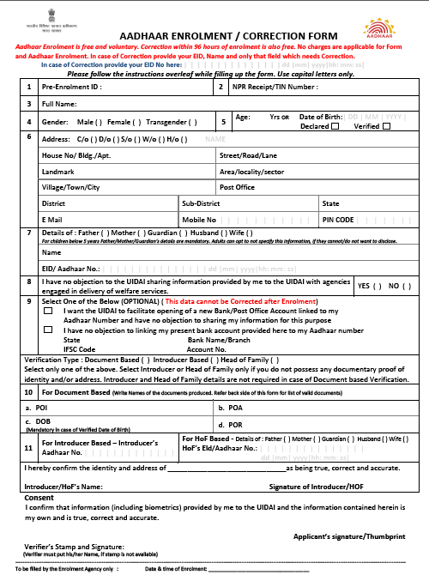
Enrolment Form
The resident has to fill the Enrolment Form
If the resident has any difficulty in filling the Enrolment Form, the Verifier can guide the resident in filling up the Form
Verifier will verify the Enrolment Form details and photocopies against PoI/PoA/DoB/PoR documents; even if pre-enrolment data is used
Operator must enter enrolment data from verified Enrolment Forms only
Notes:
Trainer to say:
<read out the text from the slide>
PoI – Proof of Identity
PoA – Proof of Address
DoB – Date of Birth
PoR – Proof of Relationship

Slide 27
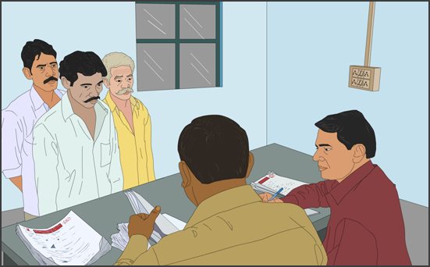
Capturing residents’ demographic and biometric data
Step 2: Verification and storage of Resident’s Documents
Verifier verifies resident’s documents
• If pre-enrolment data is used, Verifier present at the Enrolment Centre will verify documents like Ration Card, NREGA job card, etc.
• In case an enrolment form is used for filling demographic data, then the Verifier will validate form details against PoI, PoA, DoB, HoF documents.
• Verifier will then sign and stamp the photocopies of documents verified.
Notes:
Trainer to say:
<Readout the text from the slide>

Slide 28
Capturing residents’ demographic and biometric data
Step 3: Enrolment Operator imports Pre-enrolment data into the Aadhaar Enrolment Client
• When pre-enrolment database is available, the Enrolment Operator can retrieve the residents’ data by entering the Registrar’s Identifier in the enrolment client software.
• This reduces the time required for an enrolment, as the operator does not have to type all the information in the Aadhaar Enrolment Client’s demographic screen.
A few examples of Registrar’s Identifiers are as follows:
  Ration card number (Food and Civil Supplies Department as Registrar)
  Job card number (Rural Development Department as Registrar)
  Policy number (LIC as Registrar)
  TIN (RGI as Registrar)
  Electoral Photo Identity Card (EPIC) number (Election Commission as Registrar)
  Permanent Account Number (PAN) number (Income Tax Department as Registrar)
Notes:
Trainer to say:
<Readout the text from the slide>

Slide 29
Capturing residents’ demographic and biometric data
Step 4: Enrolment Operator enters the NPR Receipt Number, if specified in the Enrolment form
The RGI official has provided NPR Receipt Number / schedule no. to the household / individual.
Operator checks whether the NPR number has been specified in the Enrolment form.
The Operator enters the NPR number in the enrolment software.
Notes:
Trainer to say:
<Readout the text from the slide>

Slide 30
Capturing residents’ demographic and biometric data
Step 5: Enrolment Operator Enters/Updates the Resident Data into the Enrolment Software
• The Enrolment Operator enters the verified demographic data into the Enrolment software from the Enrolment Form.
• If data has been retrieved using Registrar’s Identifier, then Enrolment Operator checks and corrects or completes the resident’s demographic information.
Notes:
Trainer to say:
<Readout the text from the slide>

Slide 31
Capturing residents’ demographic and biometric data
Step 6: Enrolment Operator Records Resident’s Consent for Information Sharing
• The Operator has to capture resident’s option specified in the Enrolment form by selecting appropriate the option in the enrolment software as “Yes/No”.
Notes:
Trainer to say:
<Readout the text from the slide>

Slide 32
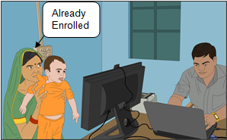
Capturing residents’ demographic and biometric data
Step 7: If Resident is Less than 5 Years Old – Enrolment Based on Parent/Guardian Details
• In case of children below the age of 5 years, one of the parents’ or guardian’s name and Aadhaar / Enrolment ID shall be recorded. This is compulsory.
• If the child is being enrolled along with the father/mother/guardian who has not enrolled for Aadhaar, the Operator will first enroll the parent/guardian and record the parent’s Enrolment ID in the child’s Enrolment form.
Notes:
Trainer to say:
<Readout the text from the slide>

Slide 33
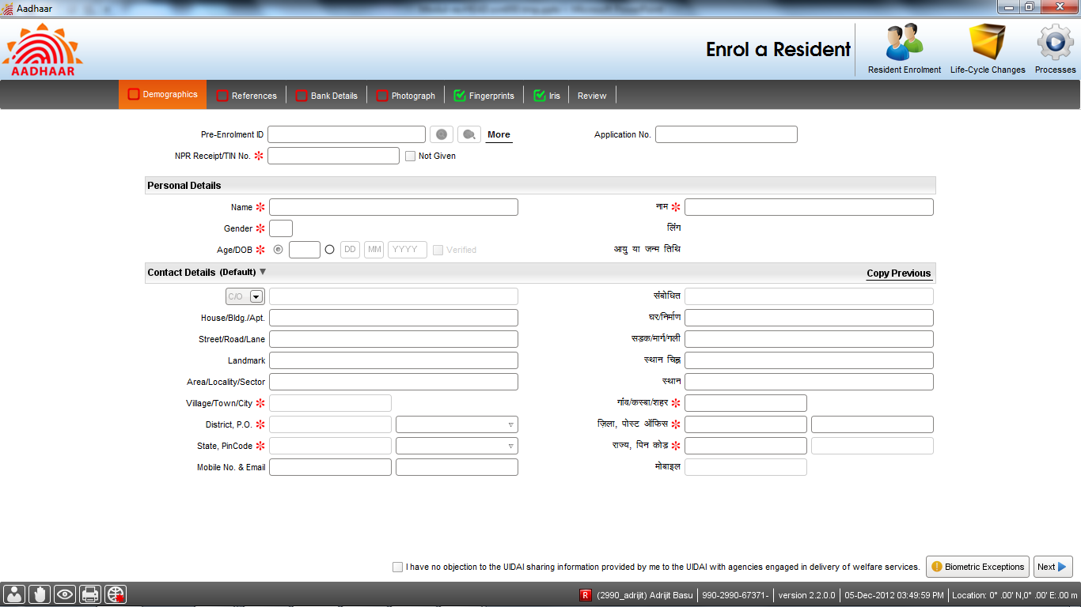
Capturing resident’s Demographics Data, References and Banking Information contd..
Figure 14: Demographics Data Capture Screen
Notes:
Trainer to say:
What is the implication of those Red star marks?
Can you see the fields on the Right Hand Side of the screen? They are in Hindi. What are these? How are they filled?

Slide 34
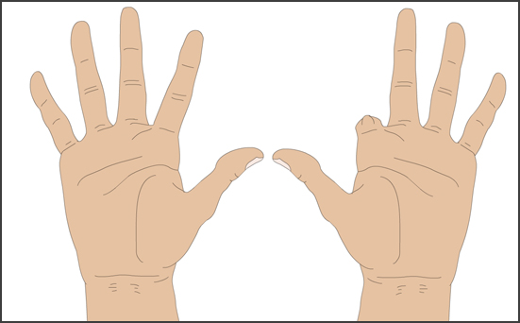
Capturing residents’ demographic and biometric data
Step 8: Enrolment Operator Checks if the Resident has any Biometric Exceptions
• Enrolment Operator checks to see if resident’s eyes and fingers are missing / amputated and Enrolment Centre Supervisor verifies the same.
• If the resident has any biometric exceptions, these also have to be captured on the demographic screen in the form of biometric exceptions.
• Operator enters details of “Missing Eye Indication” or “Missing Finger Indication” as appropriate.
Notes:
Trainer to say:
<Readout the text from the slide>

Slide 35
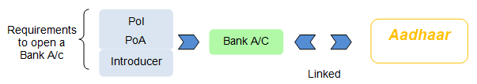
Capturing residents’ demographic and biometric data
Step 9: Enrolment Operator enters Banking options specified in the Enrolment form
• Operator checks the Enrolment form to determine whether the resident wants to link his/her current bank account to his/her Aadhaar or open a new bank account on the basis of his/her Aadhaar. Accordingly the Operator,
  Enters the Bank account details such as bank name, IFSC code and account number in the AEC as specified in the Enrolment form if the resident has an existing bank account
  In case the resident has opted to open a new account, the Operator will mention the same in the Enrolment software. An account will then be opened for that resident in future.
  Specify that the resident does not want an Aadhaar linked bank account if that has been indicated in the Enrolment form.
Notes:
Trainer to say:
<Readout the text from the slide>
<When you are reading the second point, tell them that you will discuss about the “financial inclusion” in the next slide.>

Slide 36
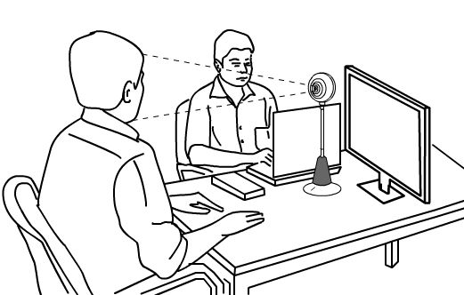
Capturing residents’ demographic and biometric data
Step 10: Enrolment Operator Captures Biometrics - Facial Image, Exception (if any), IRIS and Fingerprints
• The Enrolment operator captures the resident’s facial features as a photograph using a web camera connected to the computer.
• If the resident has “Missing Eye Indication” or “Missing Finger Indication” these should be captured as photographs using the camera
Notes:
Trainer to say:
<Readout the text from the slide>
These are some general discussion about the biometric capturing process. THE ENTIRE PROCESS WILL BE COVERED THOROUGHLY IN MODULE 5 – “Working with Biometric Devices”.
Picture of face is compulsory for all, including infants
If the resident has a biometric exception (any finger missing, any eye missing) an extra photo of the handicapped feature is captured and stored in the Aadhaar enrolment client. In such cases the Enrolment Agency Supervisor signs off the exception with his or her fingerprint

Slide 37
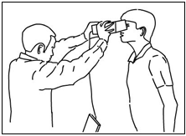
Capturing residents’ demographic and biometric data
Step 10: Enrolment Operator Captures Biometrics - Facial Image, Exception (if any), IRIS and Fingerprints (Contd..)
• The images of both Iris are captured Using an Iris Scanner device
Notes:
Trainer to say:
<Readout the text from the slide>

Slide 38
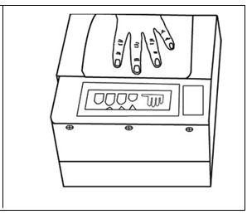
Capturing residents’ demographic and biometric data
Step 10: Enrolment Operator Captures Biometrics - Facial Image, Exception (if any), IRIS and Fingerprints (Contd..)
• The fingerprint scans of all ten fingers are to be captured using a Fingerprint Scanner device
Notes:
Trainer to say:
<Readout the text from the slide>
Iris and fingerprint scans are compulsory for residents above 5 years of age
UIDAI will monitor the performance of Enrolment Operators and check the number of times an Enrolment Operator has sent “force-capture” biometric data or substandard biometric data to CIDR
During this entire procedure the Operator will ensure that the resident does not feel any kind of discomfort

Slide 39
Capturing residents’ demographic and biometric data
Step 11: Enrolment Operator Shows Data to the Resident for Validation
• The Operator shows the data entered to the resident on a monitor facing the resident and also reads out the same to the resident, to ensure that all captured details are correct.
• The resident may ask for correction of the data and the Enrolment Operator has to make the correction in the Client Software after checking with the correct information given in the Enrolment form.
But if the resident asks for any correction that does not match the information given in the Enrolment form, the Operator must (politely) ask the resident to make the changes in the Enrolment form and get the same verified by the Verifier.
Notes:
Trainer to say:
<Readout the text from the slide>
Operator corrects the errors pointed out and again shows the data to the resident.
Operator should proceed only after the resident agrees that the entered data is correct.

Slide 40
Capturing residents’ demographic and biometric data
Step 12: Enrolment Operator gets Introducer’s / Head of the Family’s Sign-off - APPLICABLE ONLY IN CASE ENROLMENT IS INTRODUCER / HOF BASED
• In case of Introducer based enrolment, the Introducer will have to provide her/his fingerprint as sign-off, confirming that the information captured is correct. If the Introducer is not physically present at the time of enrolment, the enrolment can be verified by the Introducer at the End of the Day.
Similarly, in case of Head of the family (HoF) based enrolment, the Head of the Family will have to provide her/his fingerprint as sign-off, confirming that the information captured is correct.
Notes:
Trainer to say:
<Readout the text from the slide>

Slide 41
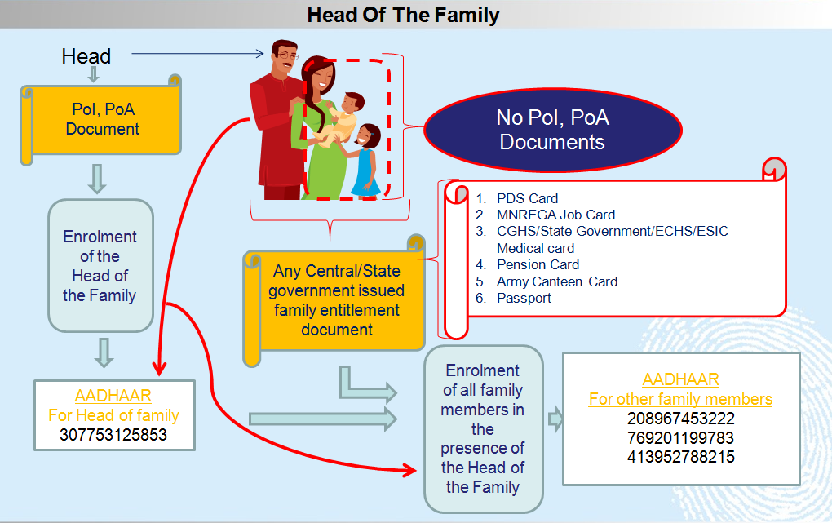
Capturing residents’ demographic and biometric data
Notes:
Trainer to say:
Head Of The Family (HoF):
Select “Head of the Family” option if the resident does not have documents and needs to be ‘introduced’ by the head of the family.
Head of the Family acts as the Introducer. In case the ‘Head of the Family’ based verification, her / his name must be present on the ‘MNREGA Job Card’ or ‘PDS Card’ etc. as the head of the family.
On selection of ‘Head of the Family’ based verification, ‘Relationship to Resident’ section will be made mandatory.
Like Introducer, the head of the family (HoF) can also verify the identity and address of the family members in specific circumstances.

Slide 42

Capturing residents’ demographic and biometric data
Step 13: Enrolment Operator Provides Sign-off for the Data Capture
• The Enrolment Operator provides her/his fingerprint as confirmation and sign-off for the data that has been captured in the Aadhaar Enrolment Client.
Notes:
Trainer to say:
<Readout the text from the slide>

Slide 43
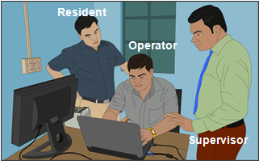
Capturing residents’ demographic and biometric data
Step 14: Enrolment Operator Gets Supervisor’s Sign-off for Exceptions, if any
• The Enrolment Agency Supervisor’s fingerprint may be needed if there are any exceptions (such as missing finger or eye). This would also be required if the biometric quality is not good and the “force capture” option is used.
Notes:
Trainer to say:
<Readout the text from the slide>

Slide 44

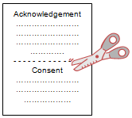
Capturing residents’ demographic and biometric data
Step 15: Acknowledgement and Consent for Enrolment
• Operator must select the language, requested by the resident, in which the legal/declaration text on print receipt is to be printed.
• The Operator prints the acknowledgement slip and the consent form in one A4 size sheet. The Operator has to tear off the sheet from centre.
• The Operator signs the Acknowledgement and gives it to the resident.
• The resident signs the Consent for Enrolment and returns it to the Operator.
• The resident’s consent is taken using his/her signature/thumb impression.
• In case resident is a child below 5 years, father / mother / guardian of the child whose enrolment ID was recorded in software will sign the Consent for Enrolment.
• The Consent for Enrolment along with the Enrolment Form, PoA, PoI & DoB proofs is then stored as per the procedures prescribed by the Registrar.
Notes:
Trainer to say:
<Readout the text from the slide>

Slide 45

Capturing residents’ demographic and biometric data
Step 16: Enrolment Operator Corrects data, if required, within 96 Hours of the Resident’s Enrolment and in the Presence of the Resident
The following requests for changes are included in the scope of the Correction Process:
    a. All demographic fields i.e., Name, Address, Gender, Date of Birth / Age
    b. Information sharing consent
    c. Consent to open a Bank Account / linking of existing Account
    d. Relationship to resident
    e. Mobile
    f. Email Address
    g. NPR Receipt Number
    h. Relationship Details(Relation type, Name and EID/UID)
    Introducer Name and UID
In case the resident is child below 5 years, the biometric of the parent/guardian whose details are entered in the relationship fields, will be taken.
Notes:
Trainer to say:
<Readout the text from the slide>
If originally the resident was enrolled as a child below 5 years of age it is invalid to correct the resident age to above 5 years because for above 5 we require biometric data as well which would not have been captured during enrolment.

Slide 46
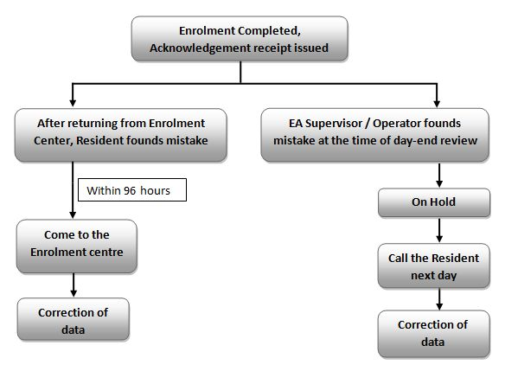
Capturing residents’ demographic and biometric data
Step 16: Enrolment Operator Corrects data, if required, within 96 Hours of the Resident’s Enrolment and in the Presence of the Resident Contd..
The EA can correct any of the above types of information for a resident using Client software within 96 hours of the resident’s enrolment and in the presence of the resident.
Notes:
Trainer to say:
<Readout the text from the slide. Explain the diagram.>

Slide 47
Capturing residents’ demographic and biometric data
Step 16: Enrolment Operator Corrects data, if required, within 96 Hours of the Resident’s Enrolment and in the Presence of the Resident (Contd..)
The EA must restrict all corrections in a resident’s data to one time only.
The resident must carry his/her acknowledgement letter for correction. PoI, PoA and Parent/Guardian’s acknowledgement letter will also be required at the time of correction process depending on the type of correction.
  A change in Name would require either a verified PoI document or an Introducer’s Name and UID.
  A change in Address would require either a verified PoA document or an Introducer’s Name and UID.
  A change in verified DoB would require a verified DoB certificate. If the correction is in data for a child below 5 years of age, then parent details of relationship type, relative name and EID/UID of parent/guardian is also mandatory.
Notes:
Trainer to say:
<Readout the text from the slide>

Slide 48
Capturing residents’ demographic and biometric data
Step 16: Enrolment Operator Corrects data, if required, within 96 Hours of the Resident’s Enrolment and in the Presence of the Resident (Contd..)
The previous Enrolment ID of the resident needs to be entered for correction of resident’s old data.
The Name of the resident whose data is to be corrected must be re-entered even if the correction is not in the name itself. Only the fields that need a correction should be entered in the software. Fields that are good in original enrolment are not to be retyped.
The resident’s photo is also captured during the correction process. The correction in data will be reviewed with the resident and any one of the biometrics of the resident (provided in drop down menu on client) will also be taken to confirm that the resident is OK with corrections.
An “acknowledgement of correction” and “consent for correction” will be printed at the end of correction process along with the resident’s photo.
Notes:
Trainer to say:
<Readout the text from the slide>
The “acknowledgement of correction” will be signed by Operator and handed over to resident. The “consent for correction” will be signed by resident and Operator should file the same.
In case Aadhaar letter is already sent to resident and correction is processed later, an “Aadhaar Letter for Corrections” will be sent to resident.

Slide 49
Aadhaar Enrolment Process – Stages
Step 1 Setting up an Enrolment Centre
Step 2 Capturing residents’ demographic and biometric data
Step 3 Backup of data and Sync
Step 4 Transferring the demographic and biometric data collected by the Enrolment Agencies to the CIDR
Step 5 Data de-duplication and Aadhaar generation at CIDR
Step 6 Mailing the Aadhaar in a letter to the resident
Notes:
Trainer to say:
Now we will discuss the Step 3 – Data backup and Sync.

Slide 50
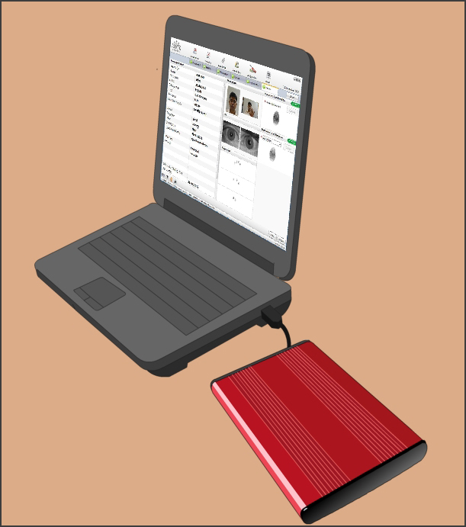
Backup of data and Sync
Data Backup
The Operator must backup the contents of the hard disk of the computer at each Enrolment Station from time to time in an external hard disk. If the data gets corrupted then the Enrolment Agency will need to re-enroll the residents which will be a loss to the Enrolment Agency. Hence taking backup is extremely important.
It is recommended that the Operator / Supervisor takes backup of data captured at least twice a day and maintains it for a period of minimum 60 days (or as specified by UIDAI form time to time).
Notes:
Trainer to say:
<Readout the text from the slide>

Slide 51
Backup of data and Sync
Sync
The Enrolment client software, after successful enrolments, needs to sync with the server every 7-10 days. The sync process requires internet connectivity. The sync typically happens only if there are any exported packets with status “Exported”. During synchronization, the operator may not be able to do any other work.
If there are no packets with the status “Exported” on the Enrolment client system, a message is displayed indicating that the sync program has been completed.
On completion of the sync, the data on the server has been exactly matched to what was available on the client machine.
At the time of sync, based on the response from the server, the client performs an appropriate action on the packets for which enrolment IDs have been synced. The server on successful sync sends three kinds of responses:
  Acknowledged Resend Not Received
Notes:
Trainer to say:
<Readout the text from the slide>
Acknowledged - The packets have been successfully received and processed.
Resend - The server would have received the packets but the packets would have failed some validations.
Not Received - The server would not have received the packet at all and it would have got dropped in transit.

Slide 52
Aadhaar Enrolment Process – Stages
Step 1 Setting up an Enrolment Centre
Step 2 Capturing residents’ demographic and biometric data
Step 3 Backup of data and Sync
Step 4 Transferring the demographic and biometric data collected by the Enrolment Agencies to the CIDR
Step 5 Data de-duplication and Aadhaar generation at CIDR
Step 6 Mailing the Aadhaar in a letter to the resident
Notes:
Trainer to say:
We have learned about the data backup and sync tasks to be followed in Step 3. Let us now look at Step 4 in detail.
<Read from the slide>
This step is also known as First Mile Logistics.

Slide 53
Transferring the demographic and biometric data collected by the Enrolment Agencies to the CIDR
Step 3: Enrolment Agency send electronic update to CIDR (Contd..)
A Note about Updates
In addition, automatic incremental updates are sent by the enrolment client software upon connection to the CIDR server.
Notes:
Trainer to say:
At the time of connection of the Enrolment Station computer with CIDR the enrolment client software automatically sends incremental updates.

Slide 54
Transferring the demographic and biometric data collected by the Enrolment Agencies to the CIDR
Step 3: Enrolment Agency send electronic update to CIDR (Contd..)
WEEK | RECORDS
Week 1 | Manifests for record numbers 1–50 are sent. Records 34, 37 and 45 are found to be corrupt.
Week 2 | Manifests for record numbers from 51 onwards are sent. Also, records 34, 37 and 45 that were found to be corrupt are resent.
Notes:
Trainer to say:
Let us understand how updates are sent with the help of an example.
Suppose the software has sent the manifests for record numbers 1 – 50 on week 1, on week 2 the software will send the manifests of records 51 onwards. If CIDR finds that some of the records received on the memory stick are corrupt, then the CIDR will instruct the enrolment client software to re-send those records at the time of the next export. Hence, to continue with the previous example, if records number 34, 37 and 45 were found to be corrupt in the first batch sent in week 1, the same three records are automatically sent with records 51 onwards to CIDR on week 2.

Slide 55
Aadhaar Enrolment Process – Stages
Step 1 Setting up an Enrolment Centre
Step 2 Capturing residents’ demographic and biometric data
Step 3 Backup of data and Sync
Step 4 Transferring the demographic and biometric data collected by the Enrolment Agencies to the CIDR
Step 5 Data de-duplication and Aadhaar generation at CIDR
Step 6 Mailing the Aadhaar in a letter to the resident
Notes:
Trainer to say:
We move on to Step 5 now.
<Read from slide>
The UIDAI generates Aadhaar/rejection letters and gives them to India Post for printing and dispatch. Resident grievances related to rejections are addressed by the UIDAI.

Slide 56
Data de-duplication and Aadhaar generation at CIDR
Steps to show data de-duplication and Aadhaar generation
Step 1: CIDR Checks for Duplicate Data
CIDR checks the enrolment data for any duplicate entries. This is called Data De-duplication. Biometric data is the basis for de-duplication.
Step 2: CIDR Issues Aadhaar and Generates Letter
CIDR issues an Aadhaar to the resident that has cleared the de-duplication process and generates a letter informing the resident of the same.
Notes:
Trainer to say:
<Readout the text from the slide>

Slide 57
Aadhaar Enrolment Process – Stages
Step 1 Setting up an Enrolment Centre
Step 2 Capturing residents’ demographic and biometric data
Step 3 Backup of data and Sync
Step 4 Transferring the demographic and biometric data collected by the Enrolment Agencies to the CIDR
Step 5 Data de-duplication and Aadhaar generation at CIDR
Step 6 Mailing the Aadhaar in a letter to the resident
Notes:
Trainer to say:
We now come to the last and final step in the enrolment process.
<Read from slide>
This step is also known as the Last Mile Logistics.

Slide 58
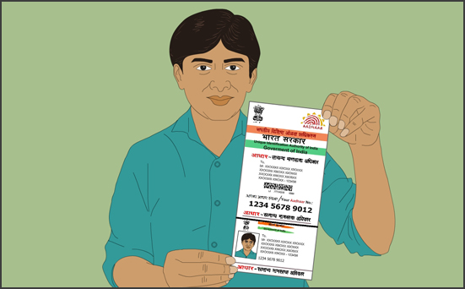
Mailing the Aadhaar in a letter to the resident
After an Aadhaar is generated by CIDR, a letter with the Aadhaar is printed and delivered to the resident. The resident gives a confirmation receipt for the letter and CIDR updates its records.
Notes:
Trainer to say:
<Readout the text from the slide>

Slide 59
Roles involved in Aadhaar Enrolment Process
Aadhaar Enrolment Process
UIDAI’s Point of Contact
Registrar
Registrar’s Supervisor / Verifier
Enrolment Agency Management
Enrolment Agency Supervisor
Enrolment Agency Operator
Technical Administrator
Introducer
Head of Family
Resident
Notes:
Trainer to say:
For all the tasks already discussed, there are number of people/organization who will take on specific roles and responsibilities, like
<Readout the names from the slide>

Slide 60
Roles and Responsibilities
Aadhaar Enrolment Process
Verify PoI, PoA, DoB documents with the photocopies and Enrolment form in case of document based verification.
Verifier also checks that the names of the documents captured in the enrolment form are correct and same as the original documents produced by the resident.
Ensure that Enrolment form is filled completely and correctly as per UIDAI enrolment process.
Verifier will sign and stamp the Enrolment Form after verification.
Where hard copy of documents is being stored, the photocopy of documents may also be verified with Verifiers signature/thumb print and stamp/Name, except in case where copies attested / certified by a public notary / gazetted officer are being submitted.
Registrar’s Supervisor / Verifier
Notes:
Trainer to say:
<Readout the text from the slide>

Slide 61
Roles and Responsibilities
Aadhaar Enrolment Process
Procure certified biometric devices
Procure other hardware and infrastructure for enrolments
Ensure enrolment software is installed on required laptops / desktops
Ensure pre enrolment data is loaded on enrolment stations laptop, where applicable.
Ensure KYR+ software integration is done and tested.
Ensure UIDAI processes and standards are followed
Assist Registrar develop enrolment schedules
Work closely with the Registrar in spreading publicity and awareness at grass-root level
Enrolment Agency Management
Notes:
Trainer to say:
<Readout the text from the slide>

Slide 62
Roles and Responsibilities
Aadhaar Enrolment Process
Ensure availability of certified operators and supervisors at enrolment centres
Ensure adequate stationary and other logistics related material are available at the centre
Ensure adequate backup arrangement at enrolment centre
Take remedial / corrective action in case of process / quality deviations and addressing the grievances
Enable successful data transfer to CIDR
Must adhere to Safety Procedures, Rules, Regulations, & Restrictions and shall comply with the provisions of all laws including safety and labour laws, rules, regulations and notifications issued there under from time to time.
Enrolment Agency Management
Contd..
Notes:
Trainer to say:
<Readout the text from the slide>

Slide 63
Roles and Responsibilities
Aadhaar Enrolment Process
Setup enrolment station
Supervise enrolment process
Handle issues and concerns of operators and residents
Act as an operator, when required
Ensure checklists are filled and signed
Ensure audit feedback, if any, is incorporated in the process
Manage data export to portable Hard Disk and data backup to external hard disk. Take enrolment data to a designated location for transfer to CIDR
File, back up and store enrolment data as per UIDAI guidelines
Ensure Client Sync every 24-48 hours. In case of remote locations or due to any other limitations, this time may extend to 5-7 days
Ensure on-boarding of Operators, Supervisors and Introducers on the client for local authentication
Enrolment Agency Supervisor
Notes:
Trainer to say:
<Readout the text from the slide>

Slide 64
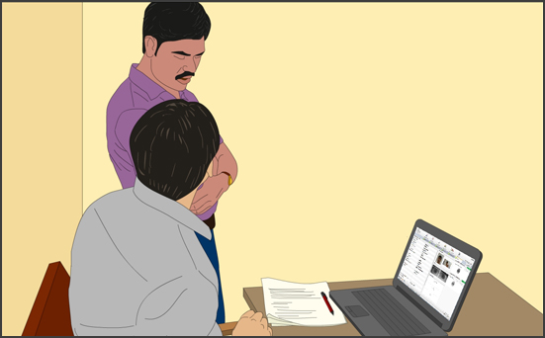
Roles and Responsibilities
Aadhaar Enrolment Process
Ensure safe handling and storage of documents and transfer of same to Registrar
Ensure that every Operator is aware of and has a printed copy of the critical points to be reviewed at the station during review of enrolment data with resident
Review all enrolments for the day to ensure that data entered in the Aadhaar client is correct for each resident. In case of any error/logical mismatch in the data entered, inform the resident to come to the enrolment centre the next day for data correction.
Enrolment Agency Supervisor
Contd..
Notes:
Trainer to say:
<Readout the text from the slide>

Slide 65
Roles and Responsibilities
Aadhaar Enrolment Process
Sign off by giving his/her fingerprint after End of Day Review
Ensure one file per station is maintained for documents storage
Ensure dockets are arranged (set of documents for a resident) in the order of enrolment and create a manifest of all enrolments along with type of documents against each enrolment
Create document batch with manifest in soft copy and hardcopy along with exception list (if any)
Once critical volume of dockets is reached, all the EID dockets are moved securely to designated Registrar offices
Handle enrolment documents with care and protect it from damage and theft
Enrolment Agency Supervisor
Contd..
Notes:
Trainer to say:
<Readout the text from the slide>

Slide 66
Roles and Responsibilities
Aadhaar Enrolment Process
Capture demographic and biometric data
Handle exception cases during capture of data
Obtain consent for enrolment and make corrections in the data recorded, if required
Provide acknowledgement slips to residents
Store Consent Letter, PoI, PoA for Registrar/UIDAI
Ensure clarity and quality of submitted document. Ensure correct documents are collected against PoI, PoA, DoB and HoF
Ensure documents for a resident are tagged together along with consent. Ensure all documents in one set belong to one resident
File documents in order of enrolment
Enrolment Agency Operator
Notes:
Trainer to say:
<Readout the text from the slide>

Slide 67

EA Beginning of Day (BoD) Activities
Aadhaar Enrolment Process
Review Setting up Enrolment Centre Checklist and ensure all requirements are in place.
Enrolment Agency Supervisor should sign off the checklist.
Notes:
Trainer to say:
<Readout the text from the slide>

Slide 68

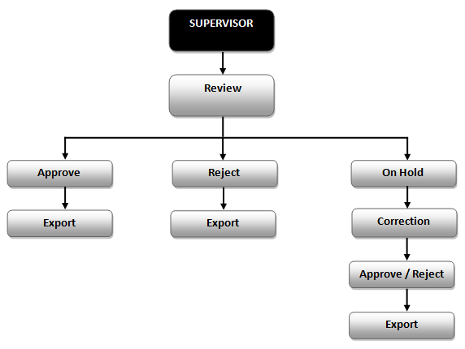
EA End of Day (EoD) Activities
Aadhaar Enrolment Process
Supervisor must Review all enrolments of the day to ensure that data entered in the Aadhaar client is correct for each resident.
Notes:
Trainer to say:
The default status of packets is ‘Approved’. Supervisor can Reject or put a packet on HOLD for Correction by giving a valid reason for same. Supervisor must sign off by giving his/her fingerprint after End of Day Review. For the packets on Hold for Correction, EA must inform the resident to come to the enrolment centre on the next day for data correction. Once correction is done to the resident's data, the Supervisor will again manually Approve/ Reject the Resident's packet put on Hold earlier for correction, with appropriate reason if rejected. At the time of Export, those packets will be considered which have either been approved or rejected by supervisor. Packets on Hold for Correction will get auto Rejected and exported after correction window timeframe have elapsed and no action been taken on packet status.

Slide 69

EA End of Day (EoD) Activities (Contd..)
Aadhaar Enrolment Process
Packets Rejected by Introducer will not be available to the Supervisor for Review. These packets will get exported when Export is called.
Export Data for transfer to CIDR
Maintain a Register for data exported. Record date, station number and packets exported at each station.
Take End of Day back up (note that backup is required twice a day preferable one during lunch time and another at end of day. Backup needs to be maintained for at least 60 days) and record the date and station number where the backup was done in the Register
The number of consents for enrolment should match the number of packets exported.
SFTP
Notes:
Trainer to say:
<Readout the text from the slide>

Slide 70
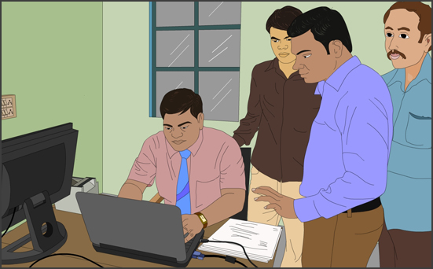
Aadhaar Enrolment Process
EA End of Day (EoD) Activities (Contd..)
End of Day meeting at centre for sharing learning-of-the-day and issues faced.
Make arrangements for replacement of faulty devices, hardware and other logistics for next day enrolments.
Hand over completed documents (PoI, PoA and Consent Form) and enrolment forms to Registrar’s Supervisor with pickup list of documents.
Ensure all devices and laptops are shut down. Check power off to avoid accidents. Ensure security arrangements for devices and other equipments.
Specific End-of-Day Reports are available on the client, for selected time period, to facilitate EA Operations. This includes Hold and Reject Reports for Enrolment Station.
Notes:
Trainer to say:
<Readout the text from the slide>

Slide 71

Questions
Thank you
Notes:
Trainer to ask:
As we come to the end of this module, do raise your hands and ask any question related to what we have just discussed and clear all your doubts.

