Slide 1
Module - 3
Biometric Data Entry

Slide 2
Objectives
At the end of this module, you will learn about:
Biometric data
Different types of Biometric devices
Process of capturing image of face
Steps involved in capturing fingerprint data
Handling the iris image capturing device
Notes:
Trainer to say:
<read form the slide>

Slide 3
Hardware Devices
The hardware devices used for the enrolment of resident can be classified into two categories:
  Biometric Devices
  Non-Biometric Devices
Biometric Devices are used to capture biometric details such as fingerprints, iris patterns and facial photograph for each Enrollee. These devices are as follows.
  Fingerprint Scanner
  Iris Capturing Device
  Digital Camera
Notes:
Trainer to say:
To enroll an Enrollee we require some hardware devices. Let us see what are they.

Slide 4
Hardware Devices
Non-Biometric Devices are used to enter, read, store, print, scan and photocopy the data. The devices such as UPS and electric generator are used to deal with power related issue. These devices are as follows.
  Computer
  Printer
  Storage Devices (CD/DVD/Pen Drive/Portable hard disk)
  GPS Dongle
  Scanner
  Photocopier
  UPS
  Universal Serial Bus (USB) Hub
  Electrical Generator
You will learn about these Non-Biometric Devices later in this module.
Notes:
Trainer to say:
<read form the slide>

Slide 5
Devices Used to Capture Biometric Data
Biometrics are used to establish the identity of an individual based on the physical, chemical or behavioral attributes of the person.
Table 1: Biometric Devices and their uses
Biometric Device | Uses
Digital Camera | Facial image capture
Iris Capturing Device | Image of the Iris
Fingerprint Scanner | Fingerprint capture
Notes:
Trainer to say:
As we have seen the two types of hardware devices.
We are going to learn more on biometric devices and their uses.

Slide 6
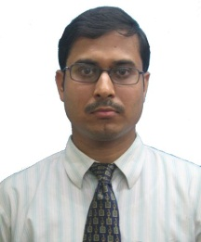
Facial Image
Photographs of face are commonly used in various types of identification cards and it is widely accepted as a biometric identifier. Face recognition systems are the least intrusive type of biometric sampling system, requiring no contact or even awareness of the subject.
A face needs to be well lit, using controlled light sources, for automated face authentication systems to work well.
  Figure 1: Digital Photograph
Even a smile can alter the features sufficiently and affect the system. Hence, neutral facial expression is required for correct verification.
Notes:
Trainer to say:
A photograph or facial image of an individual is the primitive and easiest biometric feature.
Photograph is worldwide accepted biometric identifier.
In the next slides we shall learn the device used, steps involved and guidelines to be followed while capturing a photograph.

Slide 7
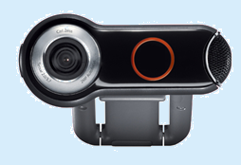
Facial Image > Digital Camera
A Digital camera is used to capture facial photograph in a digital format. It is connected to a laptop/desktop computer through the USB (Universal Serial Bus) port. The digital camera consists of an auto-focus lens and the mounting base. It displays images immediately after capturing them.
Auto-focus lens
Mounting Base
Figure 2: Digital Camera
Notes:
Trainer to say:
<read form the slide>

Slide 8
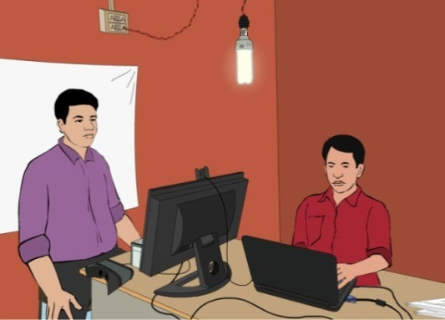
Facial Image > Steps to Capture Facial Image
Enrolment Operator should capture the facial image of an Enrollee or a Resident by using a digital camera.
Figure 3: Position of the Enrollment Operator and Enrollee
Notes:
Trainer to say:
Look at the position of Enrollment Operator and Enrollee.

Slide 9
Facial Image > Steps to Capture Facial Image Contd…
The steps to capture Face Biometric Data are as follows:
Checking the Enrollee’s Position: The photograph should be taken with the resident directly facing the camera. No head rotation or tilt is acceptable.
Adjusting the Camera: It is advised that the Operator should adjust the camera instead of changing Enrollee’s position for the right distance and posture.
Checking the Enrollee’s Expression: The Operator must ensure that the Enrollee has a neutral expression. During the capture the resident’s mouth should be closed and both the eyes must be open. For example, the Enrollee should not be smiling while being photographed.
White Background
Directly facing the camera
Neutral Expression
Notes:
Trainer to say:
<read form the slide>

Slide 10
Facial Image > Steps to Capture Facial Image Contd…
Checking the shadow/reflection: There should be sufficient light to get a proper image of the face. The Operator must ensure that there is no shadow on the Enrollee’s face and no reflection in his/her eyes. Additional light source should be placed in front of the Enrollee so that there are no shadows under the eye.
Checking the visibility of iris and pupil through Eye Glasses: If the Enrollee is wearing glasses, the photograph must be taken with the glasses on. But the Operator has to ensure that the iris and the pupil are clearly visible.
Manually Capturing the photograph: The Operator has to click a button in the Aadhaar Enrolment Client application software to capture the facial image. There is no auto capturing mechanism in case of photograph.
Sufficiently well lit
Eyes are visible through the glasses
Notes:
Trainer to say:
<read form the slide>

Slide 11
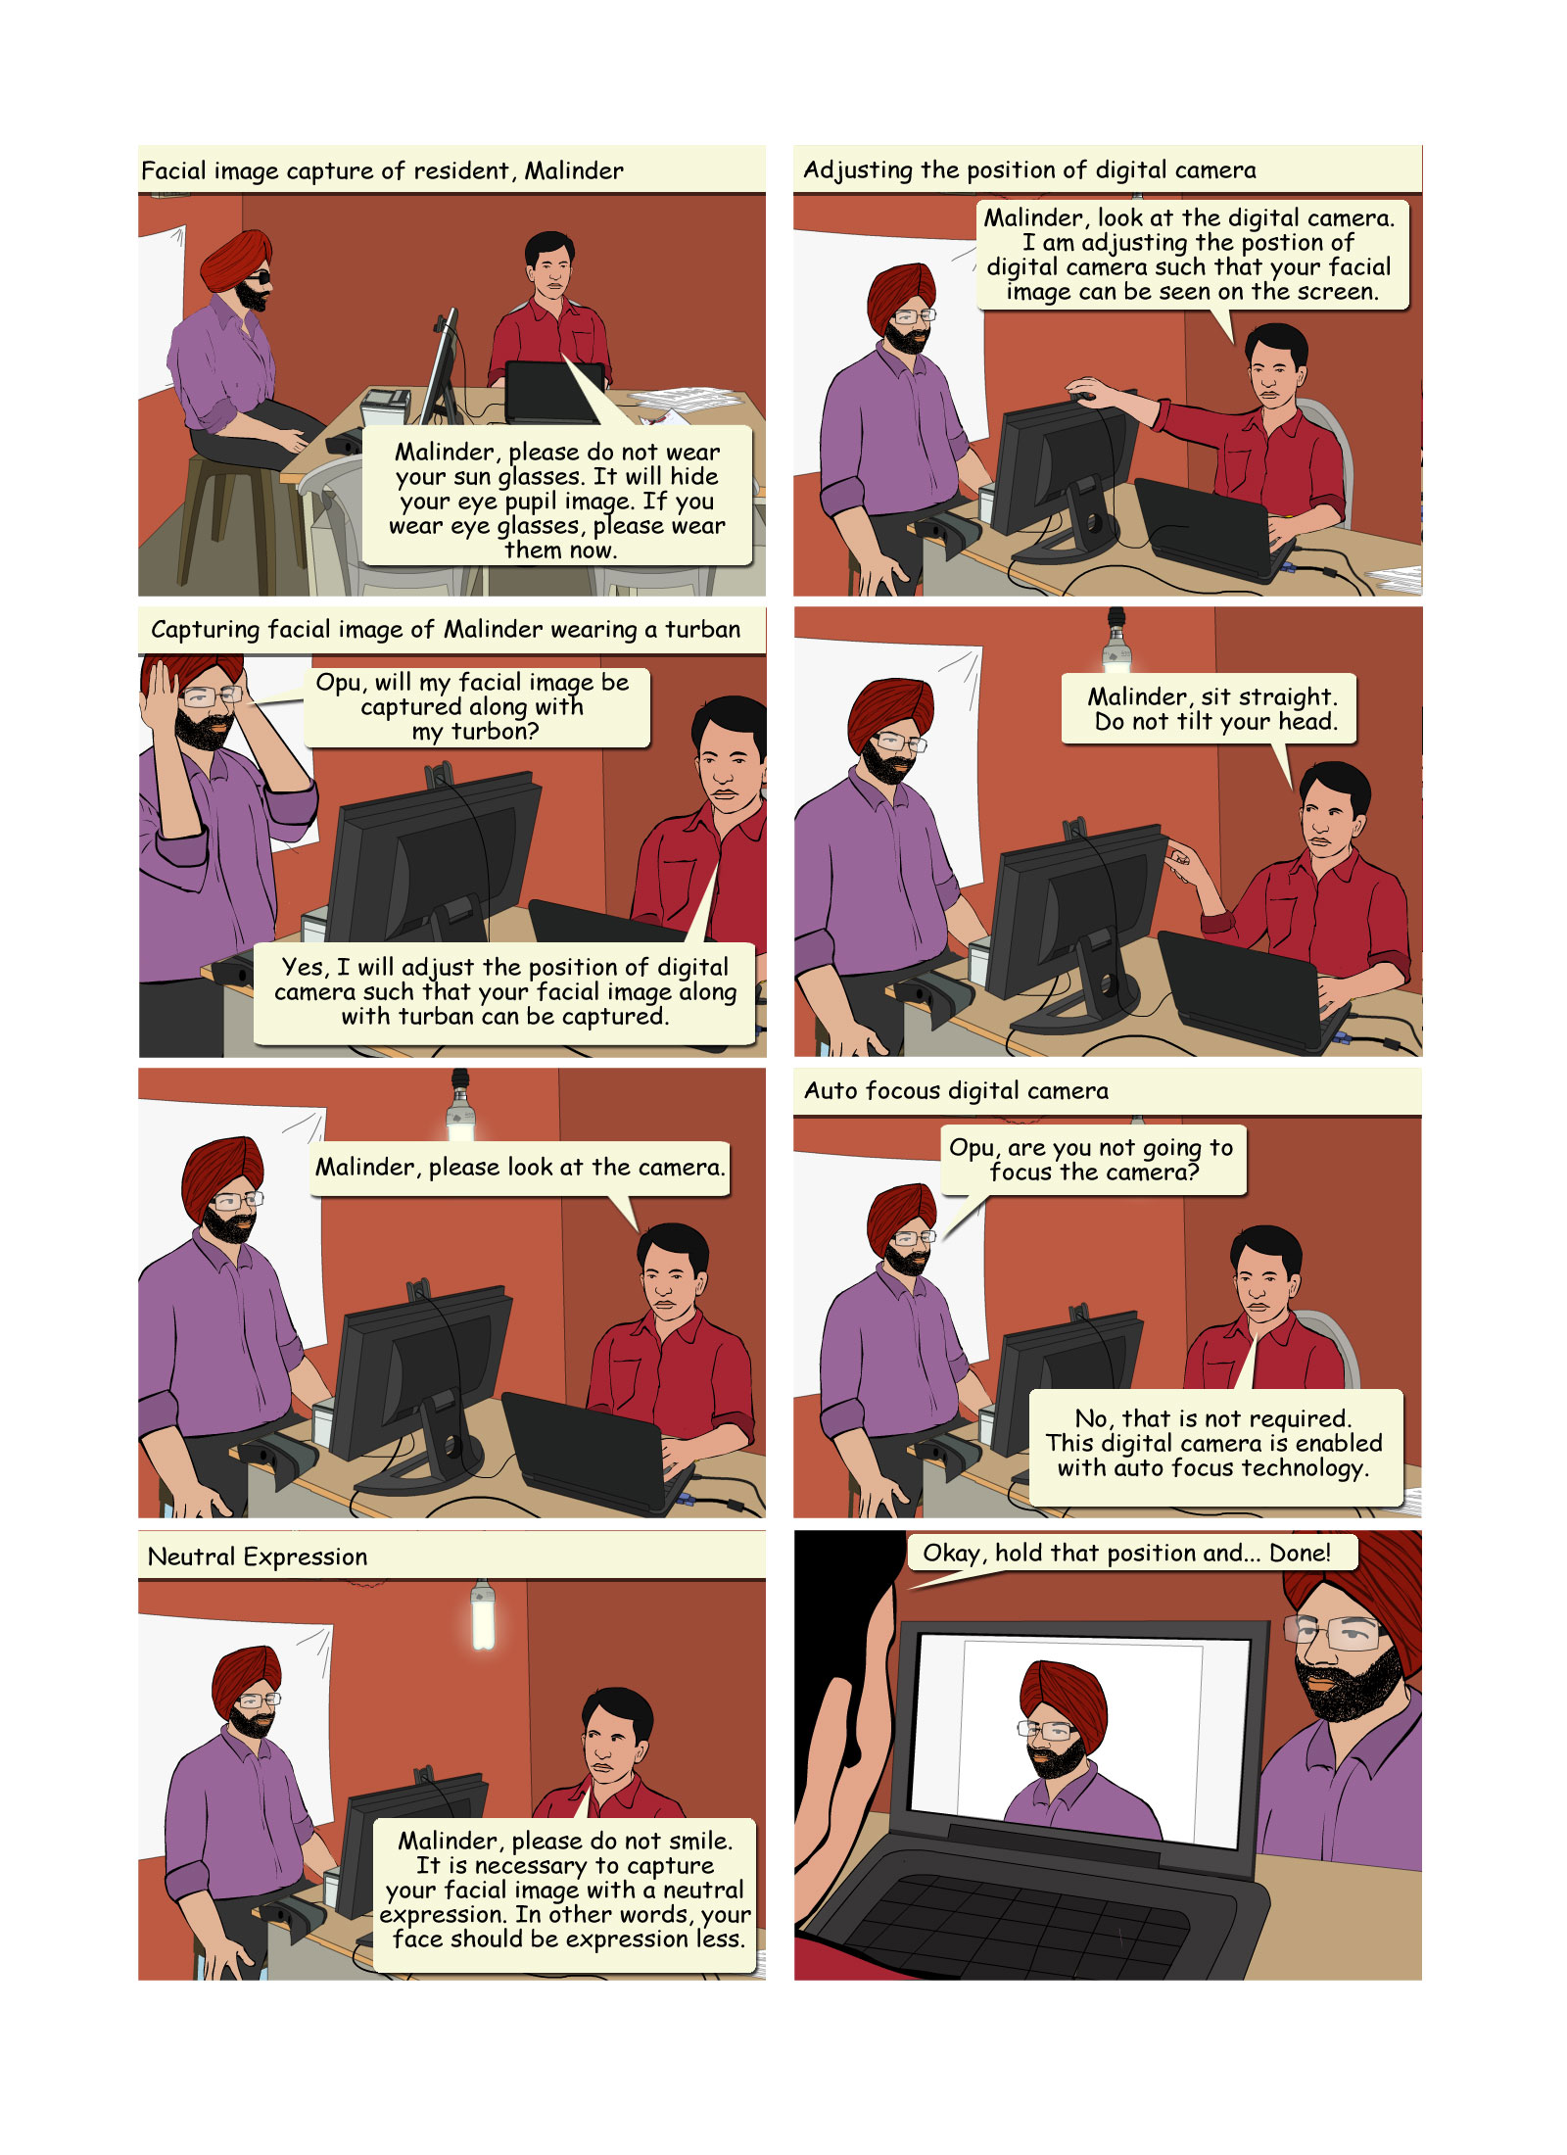
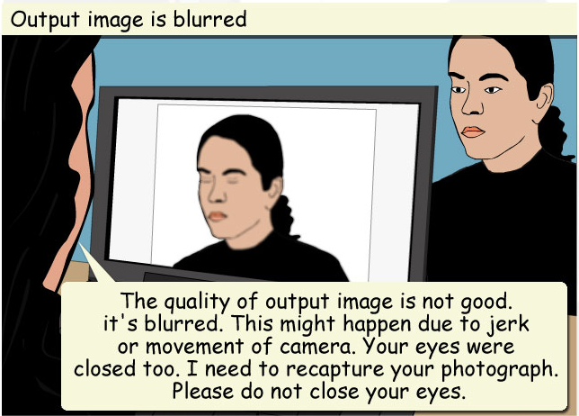
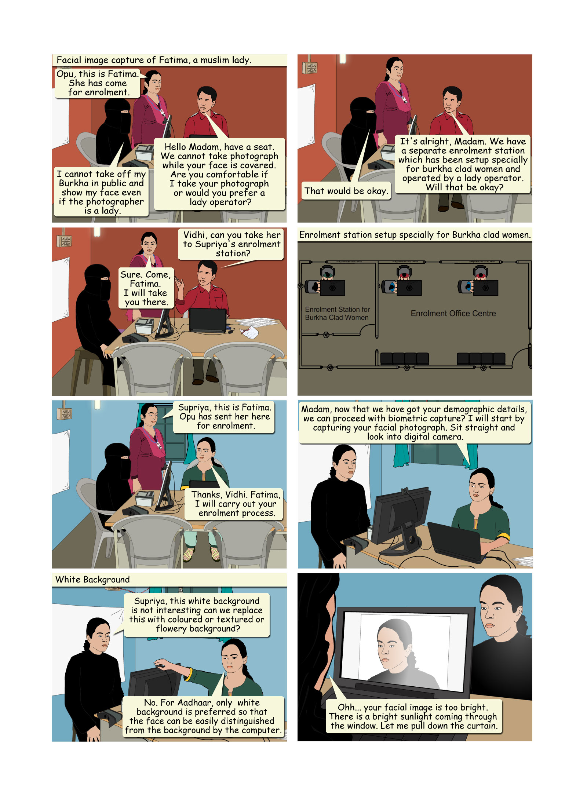
Facial Image > Guidelines for Capturing Facial Image
Guidelines for Capturing Facial Image
The digital camera used for capturing the image is enabled with auto focus technology. So it does not require any focusing adjustment by the Operator.
The Operator must ensure that the output image is not blurred because of jerks or movements of the camera. The image should neither be too dark nor too bright.
If there is insufficient light due to low voltage, then Operator can ask the Enrolment Agency Supervisor to use generator backup.
Notes:
Trainer to say:
While capturing the facial image of some important things we need to keep in mind.

Slide 12
Facial Image > Guidelines for Capturing Facial Image Contd…
If the lighting condition is not sufficient in a particular room, then Operator can ask the Enrolment Agency Supervisor to shift the Enrolment Station to a different room which has sufficient light.
In any case, the Operator should not use the flash while capturing the photograph.
It is preferable to place the backdrop (a white background behind the resident) against an opaque wall/partition.
Use of accessories that cover any region of the face is not permitted. However, accessories like eye patches due to medical conditions are allowed.
Notes:
Trainer to say:
<read form the slide>

Slide 13
Facial Image > Guidelines for Capturing Facial Image Contd…
The Operator can capture facial image of a resident wearing a turban or scarf or any other garment. He/she must ensure that the entire face of the resident is visible. The Operator has to adjust the position of the camera to get the full coverage of residents face.
While enrolling a lady resident, the lady volunteer should help the resident wherever necessary.
Notes:
Trainer to say:
<read form the slide>

Slide 14
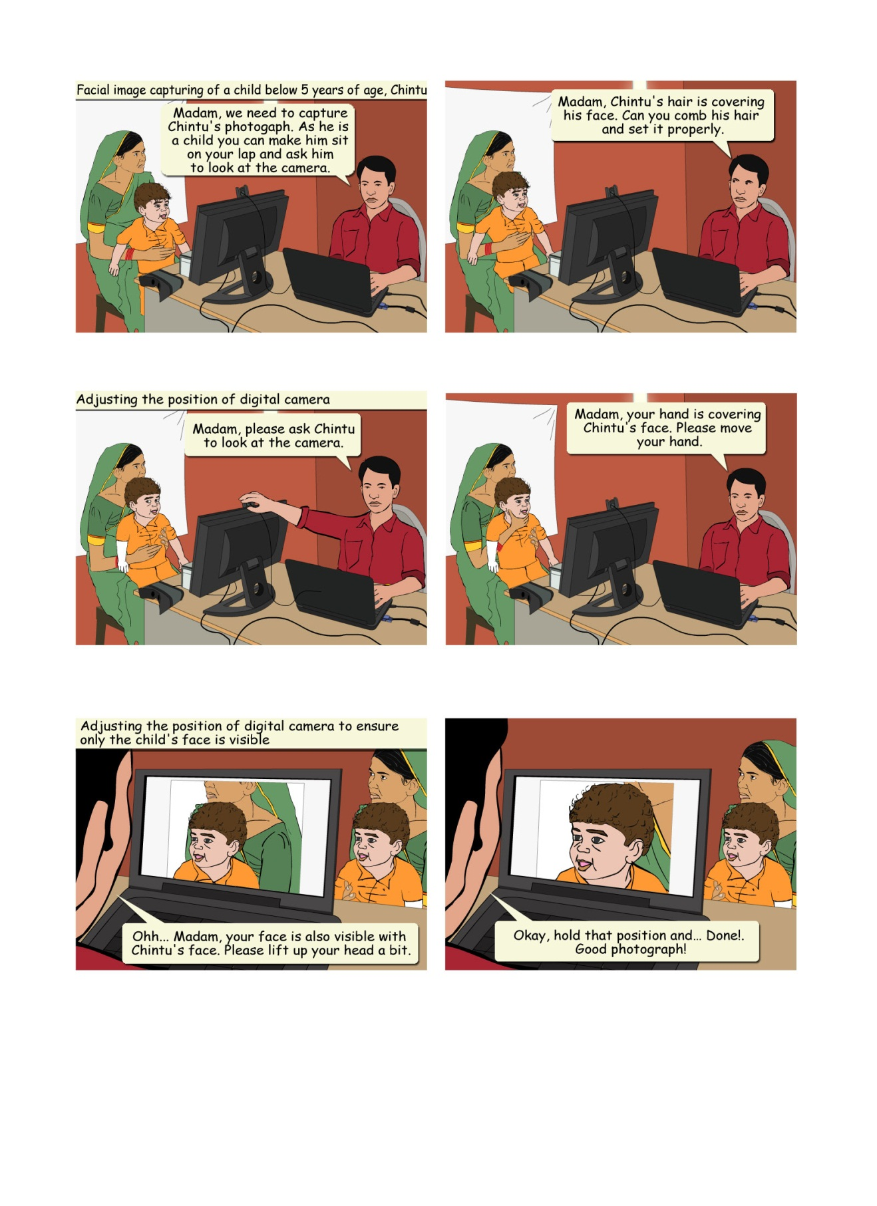
Facial Image > Guidelines for Capturing Facial Image Contd…
In case the Enrollee is a child, it may be allowed to sit on its parent’s lap. But the Operator must ensure that parent’s face is not captured along with the child’s face. The background may get rejected due to non-white screen in this case but two faces should not get captured in one picture.
Notes:
Trainer to say:
<read form the slide>

Slide 15
Facial Image > Guidelines for Capturing Facial Image Contd…
The Operator must ensure that there is proper and equally distributed lighting on Enrollees face. There should be no shadows or bright light on resident’s face and eyes.
The eye glasses of resident should be clear and transparent so that both the iris and the pupil are clearly visible. If Enrollee is wearing tinted glasses then the direct and background lighting sources should be tuned accordingly.

Slide 16
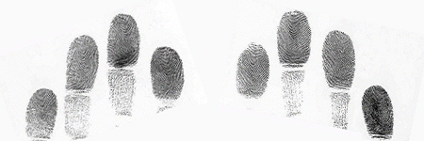
Fingerprints
The lines that you see along each of your fingers, caused by raised areas of the skin, can leave their impressions on certain types of surfaces. Such an impression is called a fingerprint.
Fingerprint is used as one of the most traditional methods for identifying an individual.
Figure 5: Fingerprint Samples
Fingerprints can be easily scanned through digital fingerprint capturing device, also known as Fingerprint Scanner. The images of fingerprints are scanned through a transparent glass plate, called the Platen, on which the fingers are placed. The resulting image is stored in the computer
Notes:
Trainer to say:
The appearance of a person’s fingerprint and the digitization process depends upon,
Age – Fingerprints of a person may change as a person grows old.
Presence of foreign matter on the fingers – like oil, dust, mud
Cuts and wounds on the fingers
Prominence of the patterns depending upon the occupation and the lifestyle of the person

Slide 17
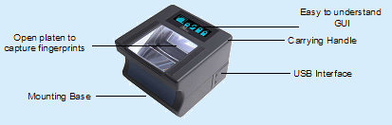

Fingerprints > Fingerprint Scanner
At the enrolment station the fingerprints are captured through digital slap Fingerprint Scanner which is connected to a laptop/desktop computer through the USB port. It comprises of a flat glass plate known as platen which helps to capture the fingerprints when fingers are placed on it.
The indicators guide the user to keep the fingers in proper place. In case of Slap Fingerprint Scanner, all the four fingers of one hand are captured, at a time. The fingerprints of both the thumbs are then captured, simultaneously.
Figure 6: Slap Scanner for Fingerprint
Notes:
Trainer to say:
What is Fingerprint Scanner? Can anybody tell something?

Slide 18
Fingerprints > Steps to Capture Image of Fingerprint
Steps to Capture Image of Fingerprint
The Enrolment Operator should obtain the fingerprints of all five fingers of each hand i.e., ten fingers of two hands. There are certain procedures which need to be followed if the person has more or less than ten fingers.
The following steps illustrate how to capture the fingerprint image of the Enrollee (Resident):
Left Hand Fingerprint
Right Hand Fingerprint
Two Thumb Prints
Auto capture
Visual Checking
Notes:
Trainer to say:
Let us learn the steps that are to be followed during Fingerprint capture.

Slide 19
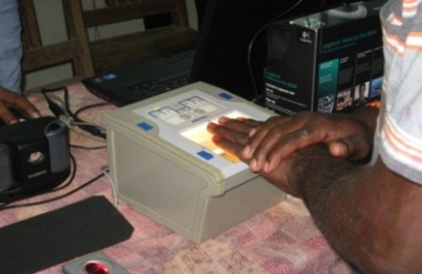
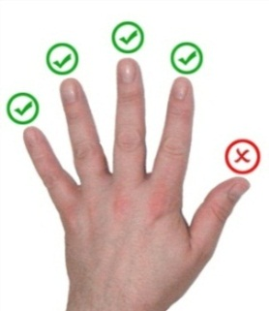
Fingerprints > Steps to Capture Image of Fingerprint Contd…
Left Hand Fingerprint: First, the fingerprints of the four fingers of the left hand except the thumb are captured simultaneously. The fingers to be scanned are illustrated in the Figure 8.
The Operator must ask the Enrollee to place the four fingers of the left hand on the platen and to apply some pressure with the right hand to have good contact with the surface.
Figure 7: Finger position on the platen
Figure 8: Figure showing the fingers to be scanned
Notes:
Trainer to say:
<read form the slide>

Slide 20
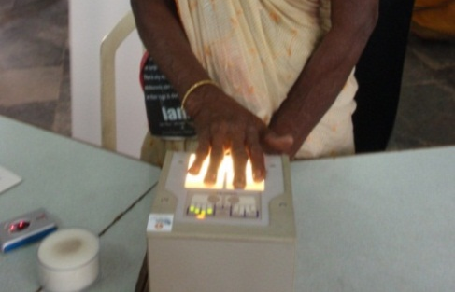
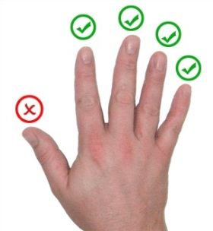
Fingerprints > Steps to Capture Image of Fingerprint Contd…
Right Hand Fingerprint: Next, the fingerprints of the four fingers of the right hand except the thumb are captured simultaneously. The fingers to be scanned are illustrated in the following Figure 10.
The Operator must ask the Enrollee to place the four fingers of the right hand on the platen and to apply some pressure with the left hand to have good contact with the surface.
Figure 9: Finger position on the platen
Figure 10: Figure showing the fingers to be scanned
Notes:
Trainer to say:
<read form the slide>

Slide 21
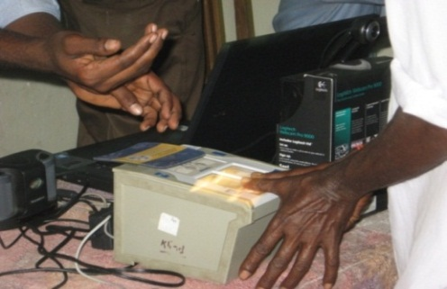
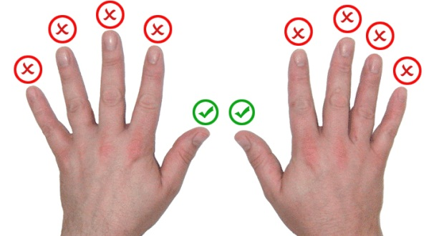
Fingerprints > Steps to Capture Image of Fingerprint Contd…
Two Thumb Prints: Thumbprints of both the hands are captured simultaneously. The thumbs are scanned as illustrated in the following Figure 12.
The Operator must ask the Enrollee to place the thumbs of both hands on the platen and to apply some amount of pressure to have good contact with the surface.
Figure 11: Thumb position on platen
Figure 12: Scanning of Thumbs
Notes:
Trainer to say:
<read form the slide>

Slide 22

Fingerprints > Steps to Capture Image of Fingerprint Contd…
Auto capture: The application software automatically captures the fingerprint when the fingers are placed on the platen. It does not require any click of the mouse or pressing of any button.
When the scanner indicates successful capture of the image, the application software captures the image of the fingerprint.
Visual Checking: Finally, the Operator should check the images of the fingerprints visually in the application software for quality and typical problems.
In case the capture quality is not good, repeat the steps given above.
Notes:
Trainer to say:
The Operator must ensure that the Enrollee uses the maximum area of the surface to get a proper scanned fingerprint image.
If the fingerprint does not get captured automatically then the Operator has to capture fingerprint manually. The software allows forced or manual capture by clicking Force Capture button. This is possible after at least one failed attempt during automatic capture.

Slide 23
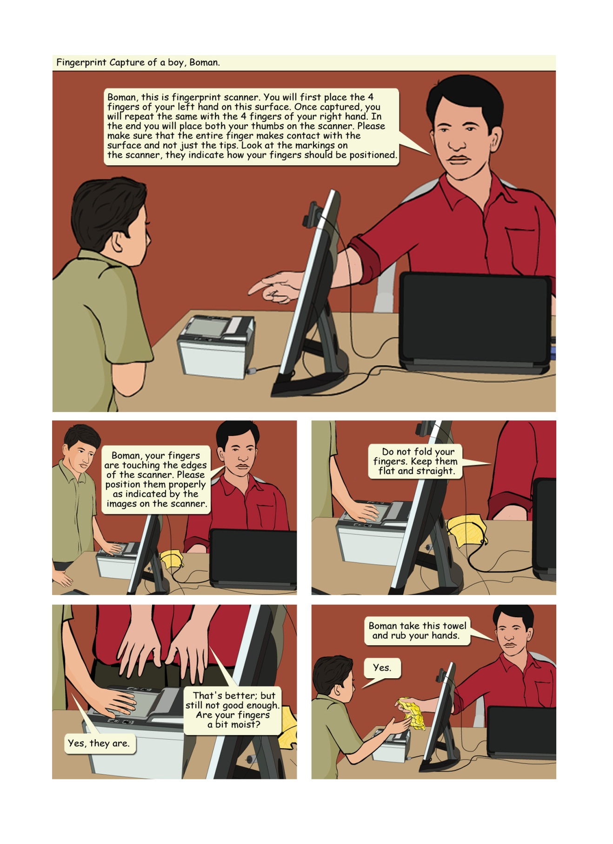
Fingerprints > Guidelines for Fingerprint Scanning
Guidelines for Fingerprint Scanning
If the image of fingerprints for an Enrollee is not proper in spite of repeated attempts, the Operator should ask the Enrollee to wash his/her hands. The Operator can provide a wet sponge or towel available at the Centre.
Notes:
Trainer to say:
While scanning the fingerprint of an Enrollee some important things we need to keep in our mind.

Slide 24
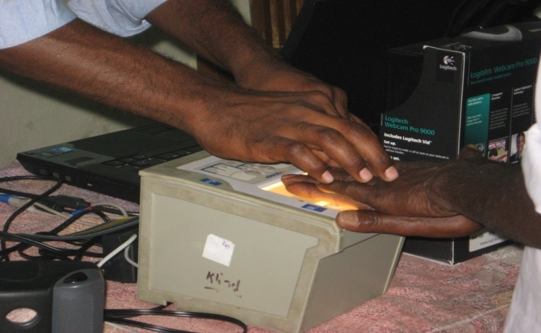

Fingerprints > Guidelines for Fingerprint Scanning Contd…
The Operator must demonstrate the way to place the fingers on the platen but he should not touch the Enrollee while demonstrating the process. The following Figure 13 demonstrates the procedure.


Figure 13: Helping the resident during Fingerprint scanning
Notes:
Trainer to say:
The images indicate the incorrect way and correct way to help the resident during Fingerprint scanning.

Slide 25
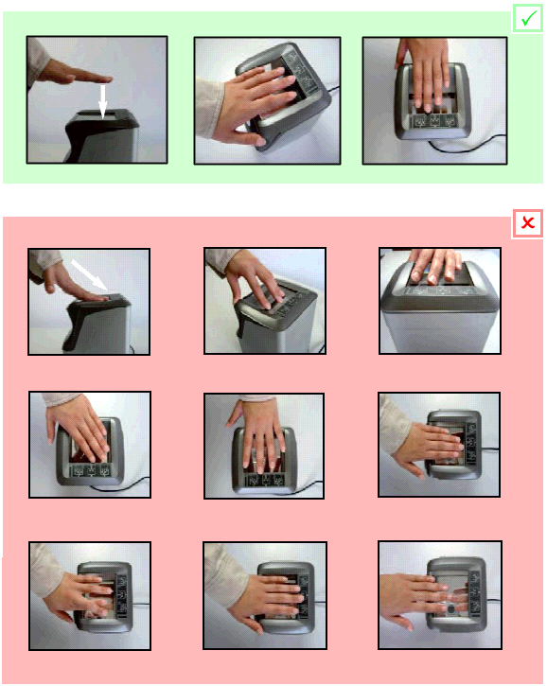
Fingerprints > Guidelines for Fingerprint Scanning Contd…
The proper way of placing the fingers on the platen are illustrated in Figure 14.
Figure 14: Correct way of placing fingers on the fingerprint scanner platen
Notes:
Trainer to say:
<read form the slide>

Slide 26
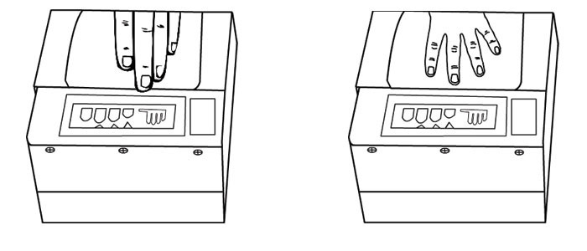
Fingerprints > Guidelines for Fingerprint Scanning Contd…
The Operator must ensure that the fingers do not touch the edge of the platen (glass surface of the fingerprint scanning device). There should be space between the fingers to capture the fingerprint image properly. No portion of the fingers should touch the edge of the platen as shown in Figure 15.


Figure 15: Correct position of fingers on the platen
Notes:
Trainer to say:
<read form the slide>

Slide 27
Fingerprints > Guidelines for Fingerprint Scanning Contd…
The Operator should request the Resident to apply some pressure on the platen to increase the area of contact and thereby obtain the requisite image quality.
For applying pressure, first the Operator has to rely on the efforts of the Resident. If he is not successful, the Operator may take the permission of the Resident and then assist him. If the Operator is enrolling a lady then he has to take the assistance of a lady volunteer present in the Enrolment Centre.
Notes:
Trainer to say:
<read form the slide>

Slide 28
Fingerprints > Guidelines for Fingerprint Scanning Contd…
If the Enrollee/resident is unable to flatten his/her fingers on the platen, the enroller/Operator can assist the resident after taking his/her permission.
If this is not successful, the Operator may try to obtain fingerprints to the extent that the Enrollee is able to flatten and place his/her fingers on the platen.
Notes:
Trainer to say:
<read form the slide>

Slide 29
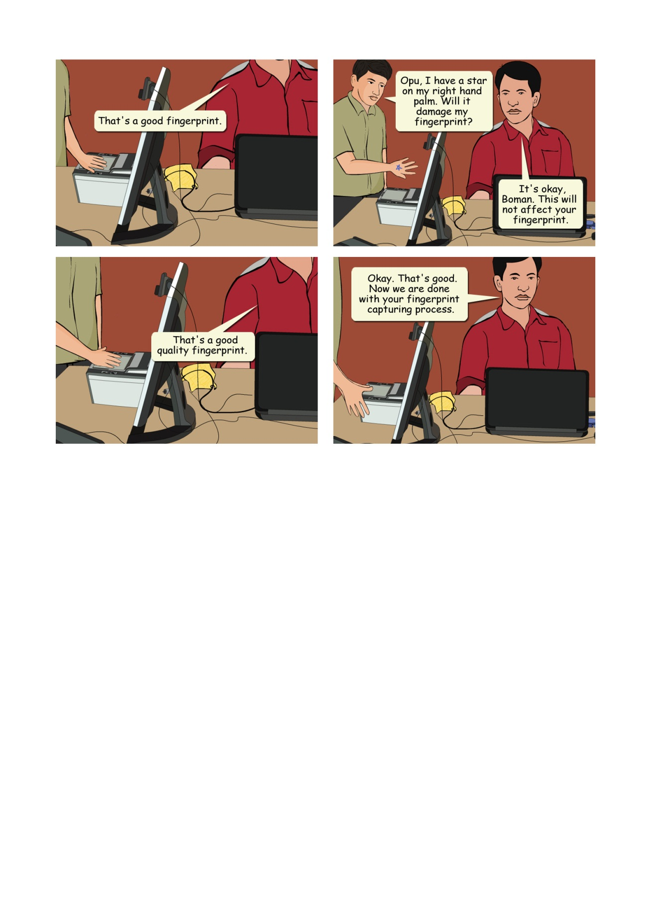
Fingerprints > Guidelines for Fingerprint Scanning Contd…
In case the enrolee has Mehendi on his/her hands, the Operator should follow the normal procedure to capture the fingerprint image. In case of worn out ridges in Enrollee’s hand, the Operator may ask to rub his/her hands to get the proper image of fingerprint.
The Operator must ensure that the fingers are placed flat and till the top joint of the finger is placed well on the scanner. There should be no direct light shining on the platen. Use the indicators on the fingerprint device for positioning of fingers. The fingers should be placed in right direction on the device.
Notes:
Trainer to say:
<read form the slide>

Slide 30
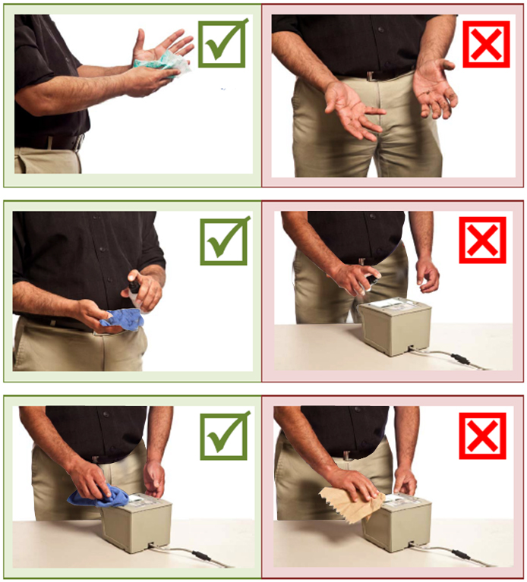
Fingerprints > Guidelines for Fingerprint Scanning Contd…
The Operator should use lint free cloth to clean the platen periodically. The procedure for cleaning the device is illustrated in Figure 16.
Figure 16: Cleaning the fingerprint scanner
Notes:
Trainer to say:
<read form the slide>

Slide 31
Fingerprints > Guidelines for Fingerprint Scanning Contd…
The Operator should periodically check the devices for scratches on the platen. During the time of enrolment the Operator should also check for out of focus or partial images of fingerprints getting captured.
Fingerprints are best captured while the resident is standing.
In case the resident has additional finger(s), the Operator should ignore them and capture the main five fingers of each hand during the time of fingerprint image capture.
Notes:
Trainer to say:
<read form the slide>

Slide 32
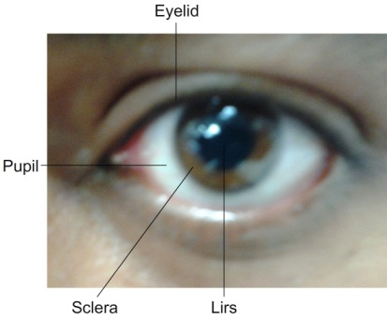
The Iris
The iris is the coloured and most visible part of human eye which surrounds the pupil. The iris controls the amount of light that enters into the eye. It is the ring-shaped region of the eye, bounded by the pupil and sclera on either side.
Figure 17: The Iris
The iris has a distinct structure that forms a pattern which can be photographed. The patterns form randomly and are highly complex.
Figure 18: Iris Patterns
Notes:
Trainer to say:
The iris photograph of an individual is the another primitive biometric feature.
In the next slides we shall learn the device used, steps involved and guidelines to be followed while capturing a iris photograph.

Slide 33
The Iris Contd…
The salient features of iris recognition and pattern matching are as follows:
The patterns do not change with time except may be due to injuries.
No two individuals’ iris patterns are similar; not even those of an individual’s left and right eye.
Spectacles and contact lenses rarely affect the quality of image capture.
This method covers a large number of people as compared with other biometric technologies.
The comparison of patterns with existing patterns is the fastest.
Notes:
Trainer to say:
<read form the slide>

Slide 34
The Iris Contd…
The iris is an inner part of our eye. Therefore the iris faces very little chance of damage. So it can be used as an ‘always available’ proof for verification for most individuals over their lifetime.
The capture of the iris image is the same as taking a regular photograph, except that it operates using the infrared light, nearly invisible to our eye. The iris capturing device captures the image of the iris and it generates an image which can be stored in a computer.
The iris is widely believed to be the most accurate biometric. Also the iris pattern of each eye is not correlated; so it gives two independent biometric feature sets.
Notes:
Trainer to say:
The iris sample acquisition is done without physical contact and without much inconvenience to the person whose iris image is being acquired.
Also, the capture time is very small.

Slide 35
The Iris > Iris Capturing Device
Iris Capturing Device is a biometric device. Two types of Iris Capturing Device are available,
  Single Iris Capturing Device
  Double Iris Capturing Device.
Single Iris Capturing Device can capture any one eye at a time while Double Iris Capturing Device can capture both the eyes at a time. Based on make and model, these devices can be hand-held or tripod-held.
At the enrolment station the iris capturing device is connected with laptop/desktop computer through USB (Universal Serial Bus) port.
Notes:
Trainer to say:
<read form the slide>

Slide 36
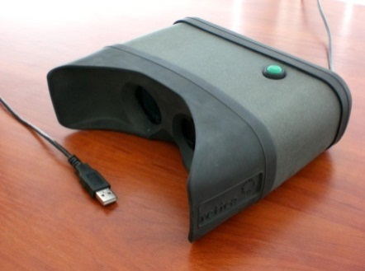
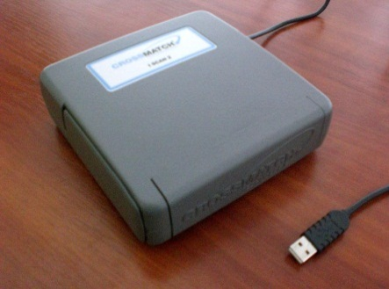
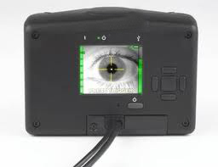
The Iris > Iris Capturing Device Contd…
No separate power supply is required to run this device. The iris capturing device gets power from the laptop/desktop computer through USB port.
Figure 19: Double Iris Capture Devices
Figure 20: Single Eye
Iris Scanner
Notes:
Trainer to say:
<read form the slide>

Slide 37
The Iris > Iris Capturing Device Contd…
Based on the functionality, there are different types of Iris Scanner. They are as follows:
Double Iris Scanner scans the images of two eyes at a time. The scanner is held by the Operator and he gradually moves the scanner towards the Enrollee’s eyes. The iris is auto scanned when the scanner is sufficiently close to the eyes.
There is another type of double iris scanner which is held close to the eyes. The scanner scans the iris one after another. But there is no need to move the scanner.
Single Iris Scanner looks like a digital camera. The scanner should be held by the Enrolment Operator and used to capture the image of one eye at a time.
Notes:
Trainer to say:
<read form the slide>

Slide 38
The Iris > Iris Capturing Device Contd…
Iris Capturing Device scans the intricate patterns (as discussed in previous section) in the iris and produces a digital image. Most of the modern Iris Capturing Devices use infrared light, which is not visible to the human eye, to illuminate the iris without causing any harm to the eyes.
Based on make and model, these devices can be,
Hand-held
Tripod-mounted
Notes:
Trainer to say:
<read form the slide>

Slide 39
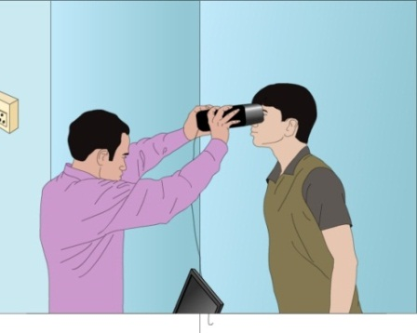
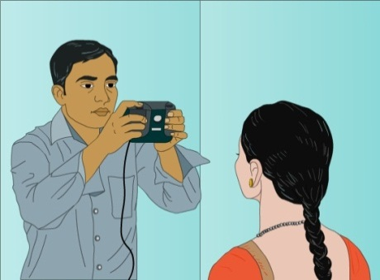
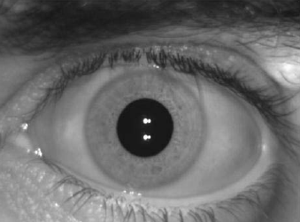
Biometric Data Entry
The Iris > Iris Capturing Device Contd…
Iris Capturing Device is a lightweight device. When the device is placed properly, it is able to automatically focus the iris. It can also adjust to various lighting conditions automatically.
Figure 21: Iris image capture and resulting image
Notes:
Trainer to say:
<read form the slide>

Slide 40
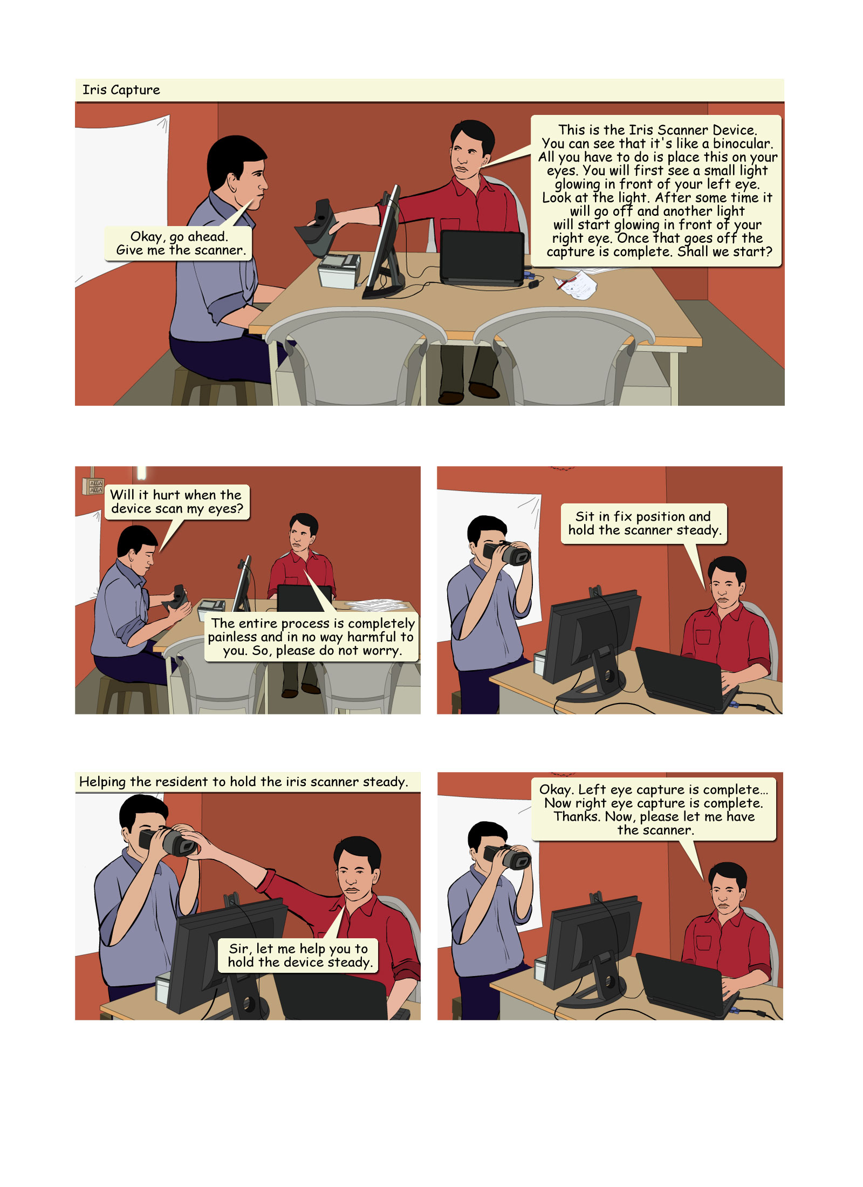
The Iris > Steps to Capture Image of Iris
Steps to Capture Image of Iris
To capture iris biometric using Iris Capturing Device perform the following steps:
Checking the Enrollee’s eyes: If capturing the iris image is not possible due to non-existence of one or both the eyes or bandage across one or both the eyes / any other deformity or disease, the same has to be recorded in the Aadhaar Enrolment Client application software.
Checking the Enrollee’s position: Request the Enrollee to sit in a fixed position. The posture should be like taking a portrait photograph.
Notes:
Trainer to say:
We will learn the steps followed to capture image of Iris.

Slide 41
The Iris > Steps to Capture Image of Iris Contd…
Aiming the Iris Capturing Device: Aim the Iris Capturing Device towards the eye of the Enrollee. The device should be held steady. In case, if the device is required to be held by the resident, the Enrolment Operator may help the Enrollee to hold the device steady.
Checking the light in the room: The iris capture process is sensitive to lighting condition present in the room. Make sure that no direct or artificial light directly reflects off the Enrollee’s eyes. Light source used for facial image capture should be switched off during the iris capture.
Notes:
Trainer to say:
<read form the slide>

Slide 42
The Iris > Steps to Capture Image of Iris Contd…
Checking the image quality: After capturing the iris image, the Aadhaar Enrolment Client application software is able to measure the iris image quality. An initial image quality assessment would be done to provide feedback to the Operator during the capture process. The device alerts the Operator if the captured iris image is of poor quality. If the captured iris image is of poor quality then try again to capture a good quality image.
Notes:
Trainer to say:
<read form the slide>

Slide 43
The Iris > Guidelines for Iris Scanning
Guidelines for Iris Scanning
If Enrollee is squint eyed and the capture of both eyes at a time is not possible, Operator may attempt recapture for one eye at a time.
If Enrollee is unable to open the eyes properly for iris scan, gently guide him/her using mimicry / play act to open the eyes wide. If that does not work, then do the best you can to capture a good quality image by using recapture.
Iris Capture Device uses auto focus and auto-capture functions. So it does not require any focusing or capturing adjustment by the Operator.
Notes:
Trainer to say:
While scanning the fingerprint of an Enrollee some important things we need to keep in our mind.
<read form the slide>
In few cases it is possible to capture iris patterns for a blind person. The iris recognition technology used by the Iris Capturing Device captures details based on iris pattern. As long as the iris pattern is visible in a blind eye, its details can be captured.

Slide 44
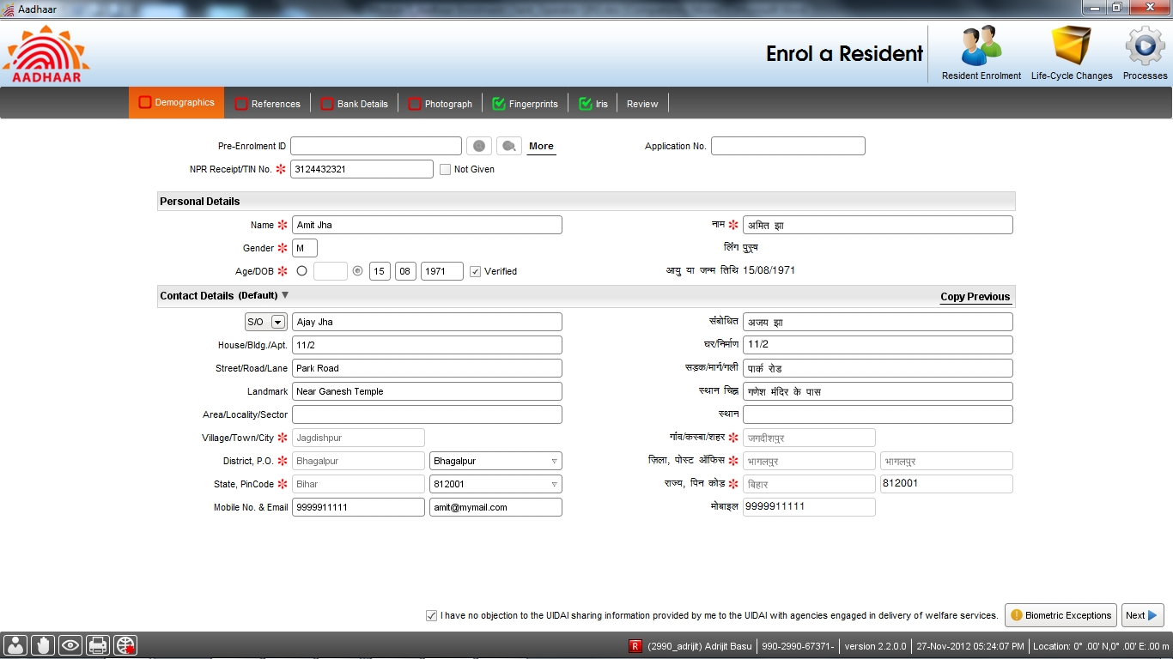
Capturing Residents Biometric Exceptions
Specifying Exceptions
To specify any biometric exceptions, click the Biometric Exceptions button on the
Demographics screen.
Click the Biometric Exception button
Figure 18: Biometric Exception Information Capture
Notes:
Trainer to say:
<read out the text from the slide>
If the resident has any deformity, the information has to be recorded on the Demographics screen.
Politely ask the resident to show her / his hands / eyes to determine suitability for capture, before clicking on the Biometric Exceptions. Verify carefully whether the resident has permanent deformity on her / his fingers / eyes.

Slide 45
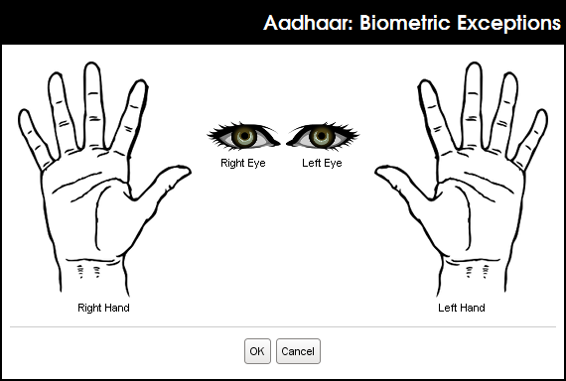
Capturing Residents Biometric Exceptions
Specifying Exceptions contd..
The following pop-up window will open.
Figure 19: Biometric Exception Capture – Before Identifying the Exception
Notes:
Trainer to say:
<read out the text from the slide>

Slide 46
Capturing Residents Biometric Exceptions
Specifying Exceptions contd..
All exceptions are to be indicated here.
Specify the resident’s biometric exceptions by clicking on the specific part of the image.
If the resident has extra finger/s, ignore the extra finger (this will not be captured as a Biometric exception).
Bandaged and finger’s with wounds, can also be marked exception.
Notes:
Trainer to say:
<read out the text from the slide>

Slide 47
Thank you
Notes:
Trainer to ask:
As we come to the end of this module, do raise your hands and ask any question related to what we have just discussed and clear all your doubts.

